Slide 1

Penicillin Allergy Delabelling
John Groumoutis, BSc(Pharm), ACPR
RIH Clinical Pharmacist

Slide 2
Learning Objectives
Discuss the health burden and risks of carrying a penicillin allergy label
Define and discuss the benefits of penicillin allergy delabelling
Evaluate and apply the PEN-FAST tool to patient cases to enable direct oral challenges and penicillin allergy delabelling

Slide 3
Faculty/Presenter Disclosure
Presenter: John Groumoutis
Relationships with financial sponsors:
  N/A
Notes:
This slide must be visually presented to the audience AND verbalized by the speaker.

Slide 4
Disclosure of Financial Support
This program has not received any financial or in-kind support
Potential conflict of interest:
  John Groumoutis is supported by and has been compensated financially by Interior Health’s Spreading Quality Improvement team for his time consulting and working on Interior Health’s Penicillin Allergy Delabelling Quality Improvement project
Notes:
This slide must be visually presented to the audience AND verbalized by the speaker.

Slide 5
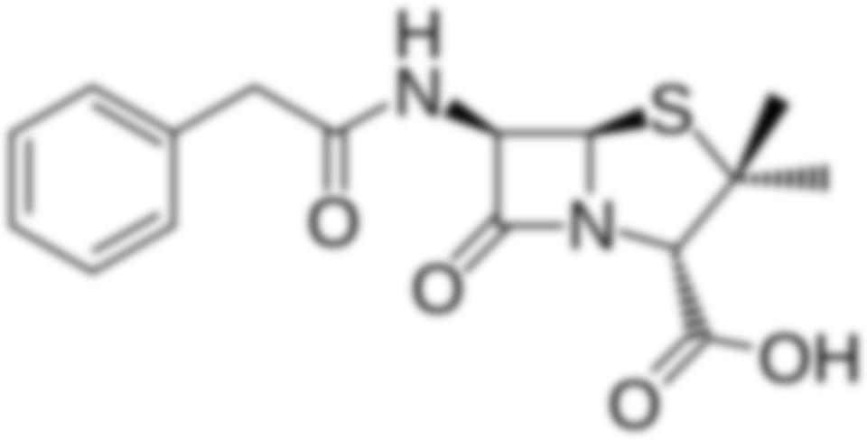
Background
https://commons.wikimedia.org/wiki/File:Penicillin-G.svg

Slide 6
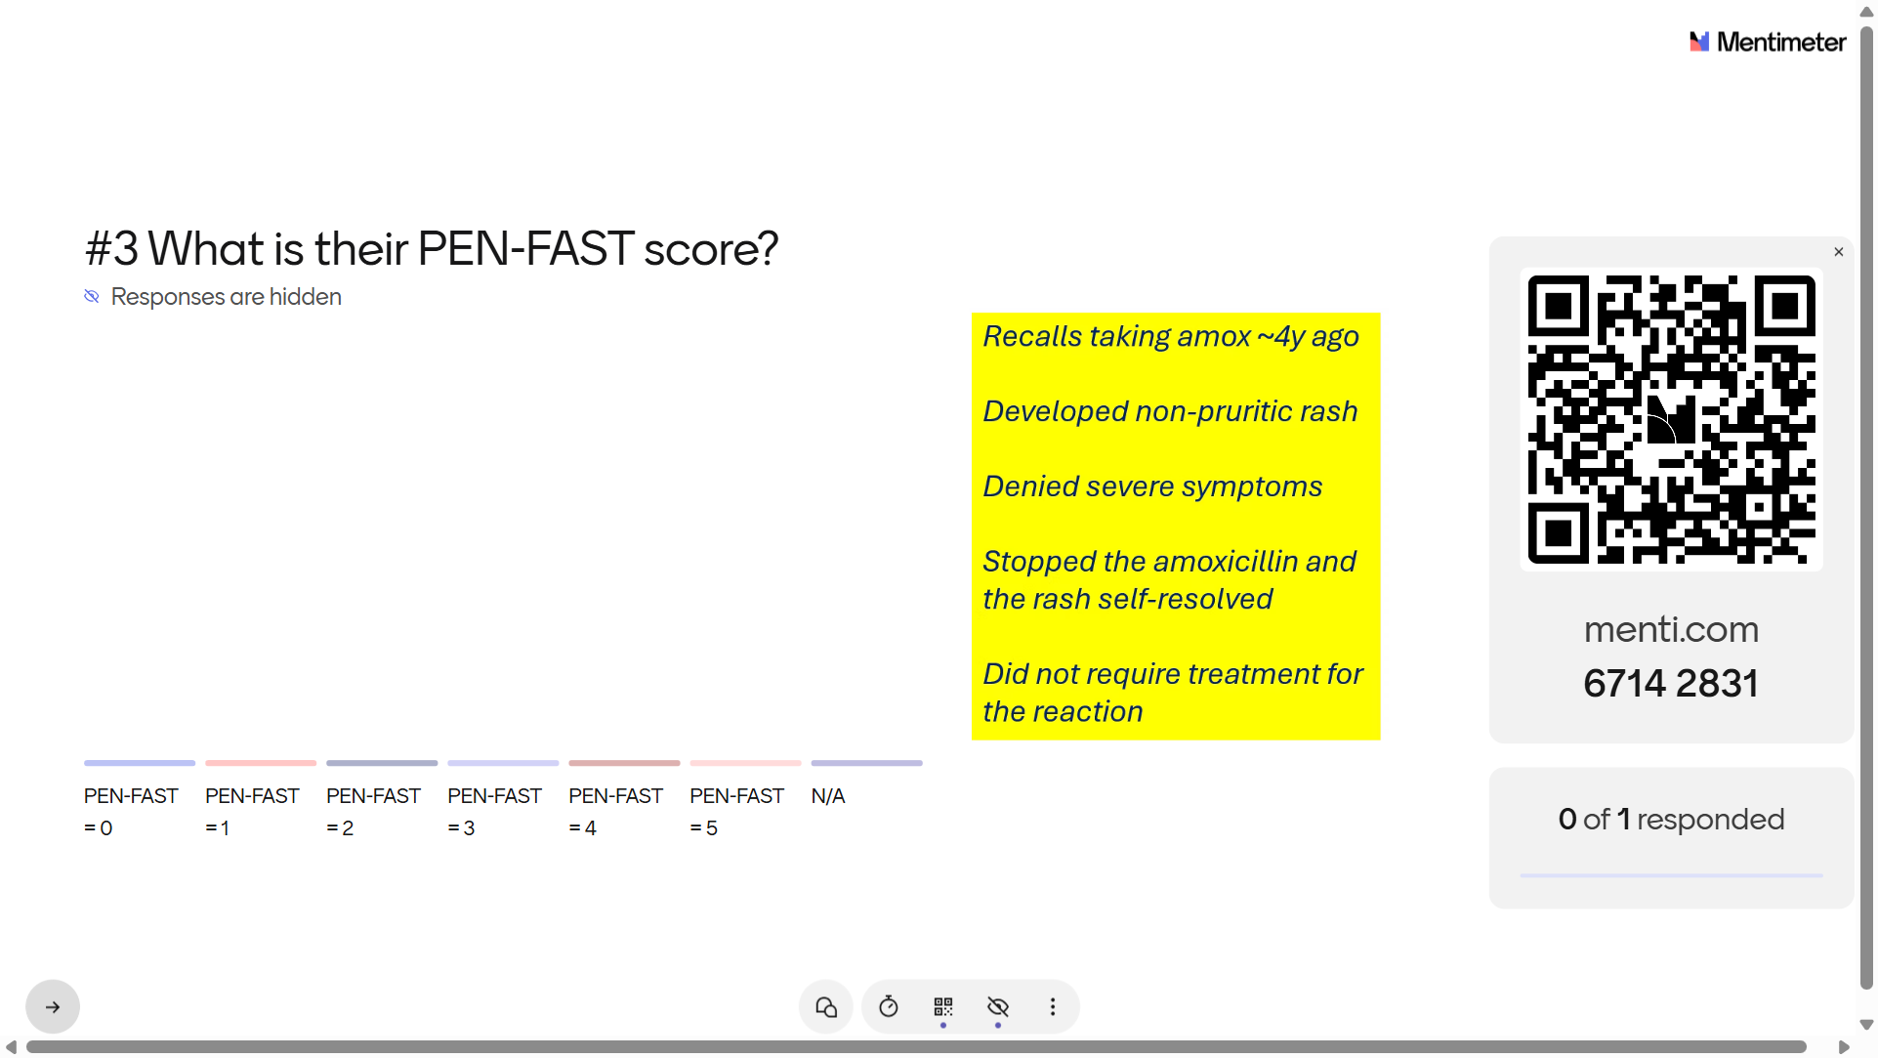

Slide 7
Penicillin Allergy Labels Cause Harm
~10% of population is labelled penicillin allergic
  When tested, only up to 2% are actually allergic
Penicillin allergy associated with:
  ↓ use of effective treatment alternatives
  ↑ risk of adverse outcomes (hospitalization, CDI, antibiotic toxicity)
  ↑ hospital stays
  ↑ medical costs
Allergy Asthma Clin Immunol. 2020 Nov 10;16(1):95.
Clin Infect Dis. 2020 Feb 28;72(6):924-938

Slide 8
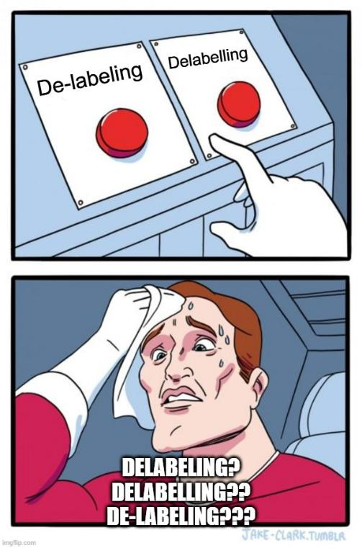
Penicillin Allergy Delabelling is – Surprise, Surprise – Removing the Allergy Label
Penicillin Allergy Delabelling is – Surprise, Surprise – Removing the Allergy Label
Allergy delabeling involves removal of the presumed allergy listing from a patient’s health record after an allergy interview and/or a negative provocation test, such as skin testing and/or direct or graded drug challenge
BC PACE Group Beta-lactam Allergy Delabeling Guide and Toolkit - https://www.bccdc.ca/Documents/PACE%20Beta-lactam%20Allergy%20Delabeling%20Toolkit.pdf

Slide 9
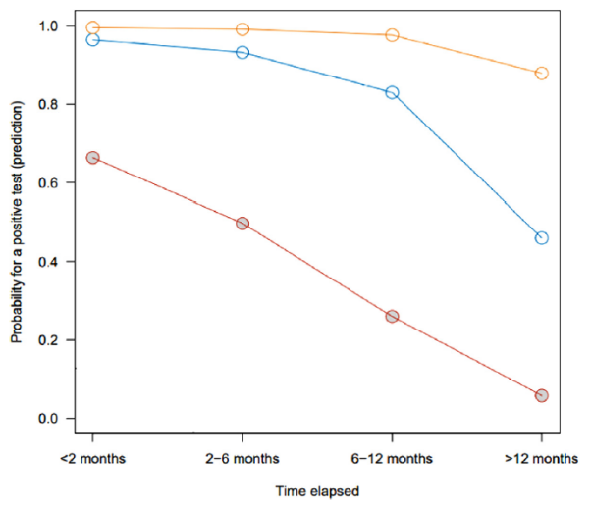
Penicillin Allergies are Outgrown with Time
Ann Allergy Asthma Immunol. 2022 Jan;128(1):27-32
Notes:
Ring and Messmer grading scale
Grade I (red) - Mucocutaneous signs: generalised erythema, extensive urticaria with or without angioedema
Grade 2 (blue) - Moderate multivisceral signs: mucocutaneous signs, moderate hypotension, tachycardia, or both with or without moderate bronchospasm or gastrointestinal symptoms
Grade 3 (yellow) – Life-threatening mono- or multivisceral signs: life-threatening hypotension, tachycardia or bradycardia with or without cardiac arrhythmia, mucocutaneous signs, severe bronchospasm or gastrointestinal symptoms
The cutaneous features may be absent before the restoration of haemodynamic stability
Grade 4 (not on graph) – cardiac arrest

Slide 10
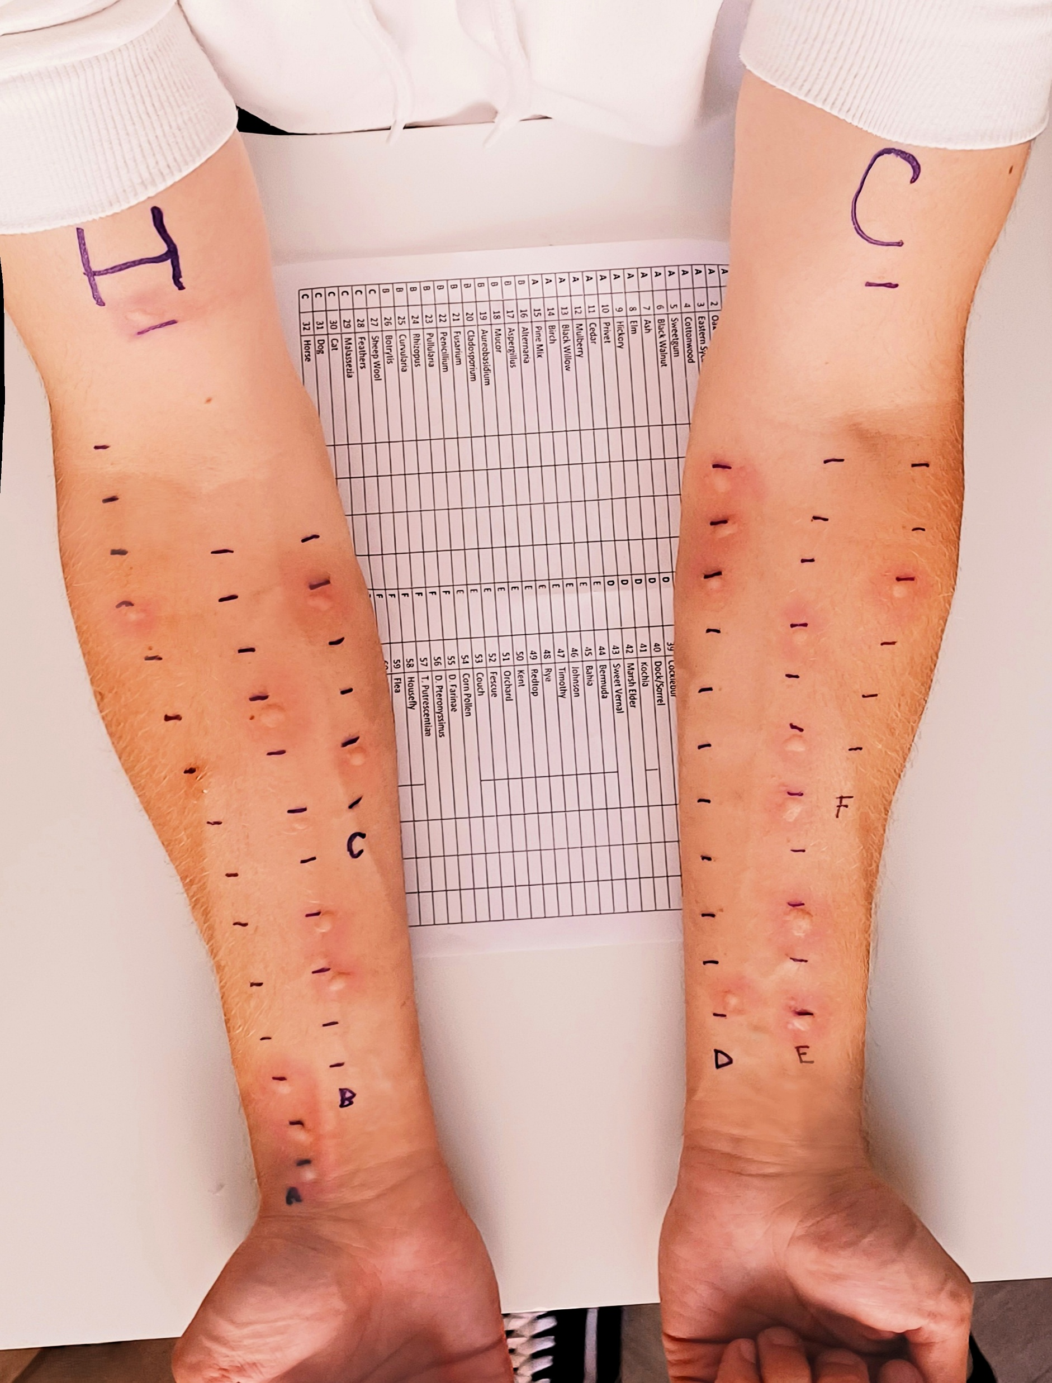
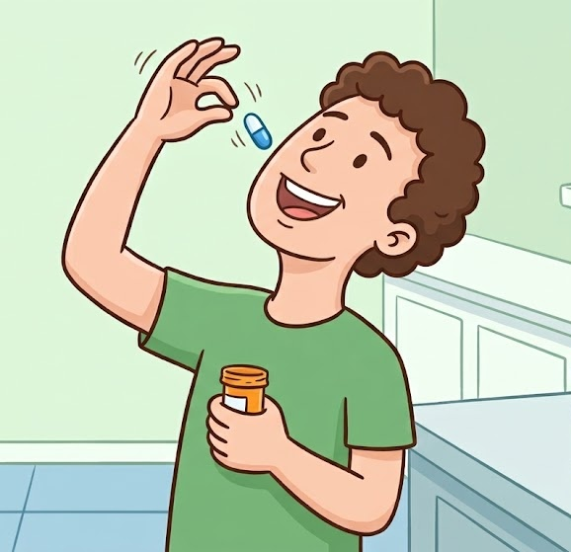
X
AMOXICILLIN
https://commons.wikimedia.org/wiki/File:Allergy_test_on_arm.jpg
Image by Gemini
Notes:
Skin testing is time and resource-intensive and generally requires allergist services
Direct oral challenging has emerged as a safe strategy to delabel penicillin allergies in low-risk patients

Slide 11

PEN-FAST
https://commons.wikimedia.org/wiki/File:Fast_aeroplane_with_motion_lines.png

Slide 12
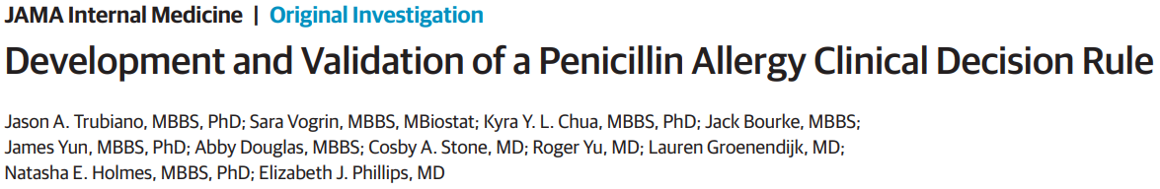
PEN-FAST Tool is Validated to Assess Risk of Labelled Penicillin Allergies
JAMA Intern Med. 2020 May 1;180(5):745-752.

Slide 13
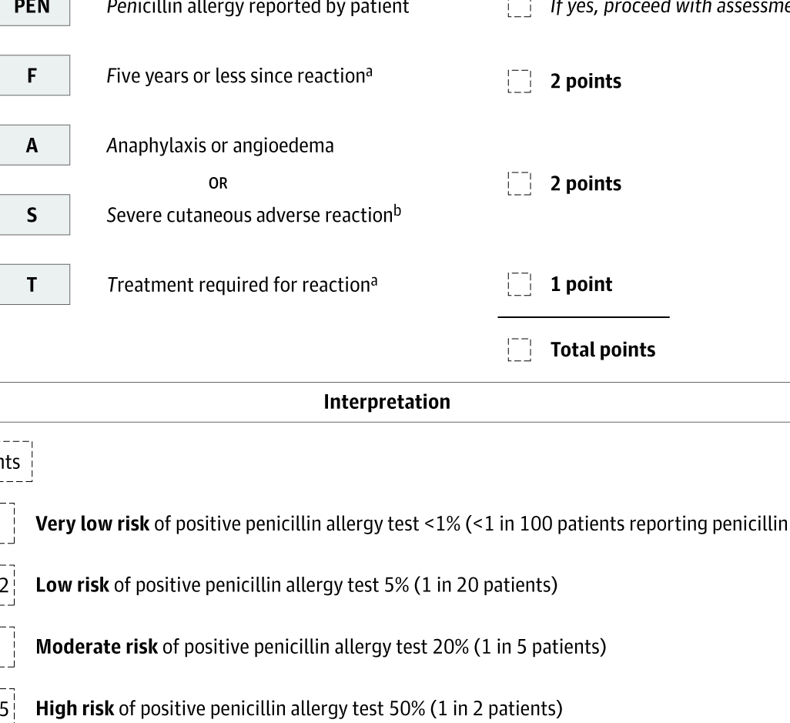
PEN-FAST Tool is Easy To Use
PEN-FAST = 0-2:
> CHALLENGE
PEN-FAST = 3-5:
> DO NOT
CHALLENGE

Slide 14
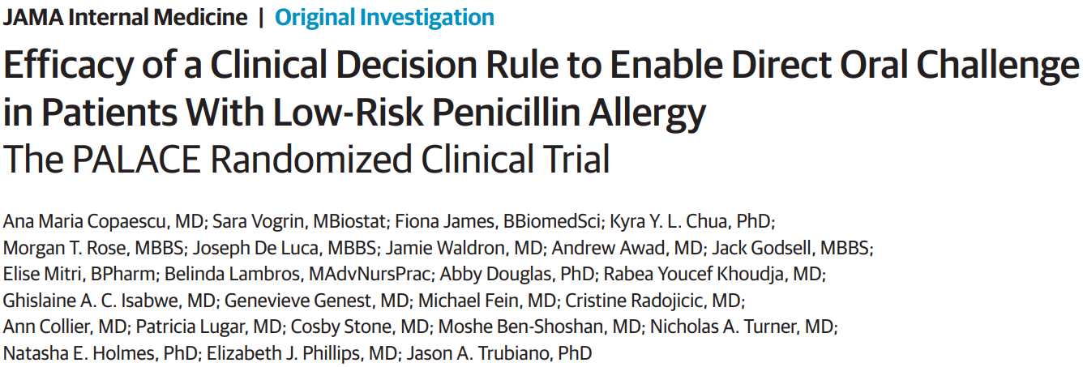
In 2023, the PALACE RCT is Published
JAMA Intern Med. 2023 Sep 1;183(9):944-952.

Slide 15
PALACE Trial (2023)
D | Parallel, 2-arm, noninferiority, open-label, multicenter, international RCT
P | Adults with PEN-FAST score ≤2
I | Direct oral challenge w/ penicillin (N = 187)
C | 2-stage testing; skin testing followed by direct oral challenge (if skin testing negative) (N = 190)
O | Primary outcome: Physician-verified positive immune-mediated oral penicillin challenge (within 1h)

Slide 16
Direct Oral Challenges for Low-Risk Patients is as Safe as 2-Stage Testing with Skin Testing
Primary outcome:
  Direct Oral Challenge: 1 patient (0.5%)
  2-Stage Testing: 1 patient (0.5%)
Both patients presented with mild cutaneous skin reactions that resolved following a single dose of antihistamine

Slide 17
Direct Oral Challenges for Low-Risk Patients is as Safe as 2-Stage Testing with Skin Testing
Secondary outcome: Immune-mediated ADE within 5d of challenge
  Direct Oral Challenge: 10 patients (5%)
  2-Stage Testing: 9 patients (5%)
No anaphylaxis, angioedema, or other serious ADEs reported in any patient

Slide 18
Author’s conclusion
In this randomized clinical trial, in patients with low-risk penicillin allergy and a PEN-FAST score of less than 3, with most patients having a PEN-FAST score of 0 or 1, a direct oral challenge with penicillin was a safe and effective alternative to the current standard, which includes 2-stage skin testing followed by an oral challenge

Slide 19
Application and Limitations of PEN-FAST
May direct oral challenge if PEN-FAST ≤ 2
Use your clinical judgment; is your patient:
  On corticosteroids?
  Medically unstable? AECOPD? AECHF? Asthmatic?
Do NOT challenge anyone with history of SCAR, regardless of PEN-FAST score
Only well validated in type I and IV hypersensitivity reactions

Slide 20
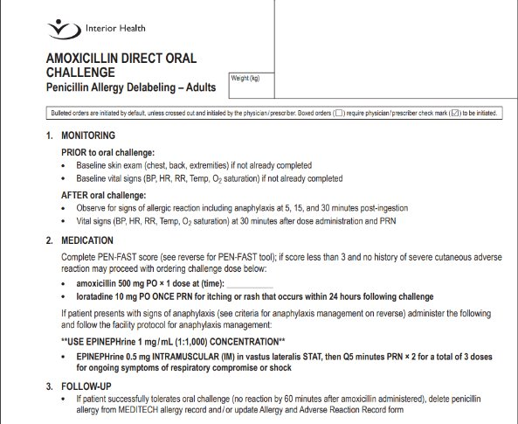

Slide 21
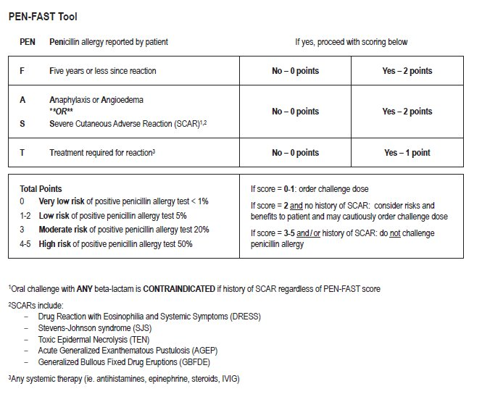

Slide 22
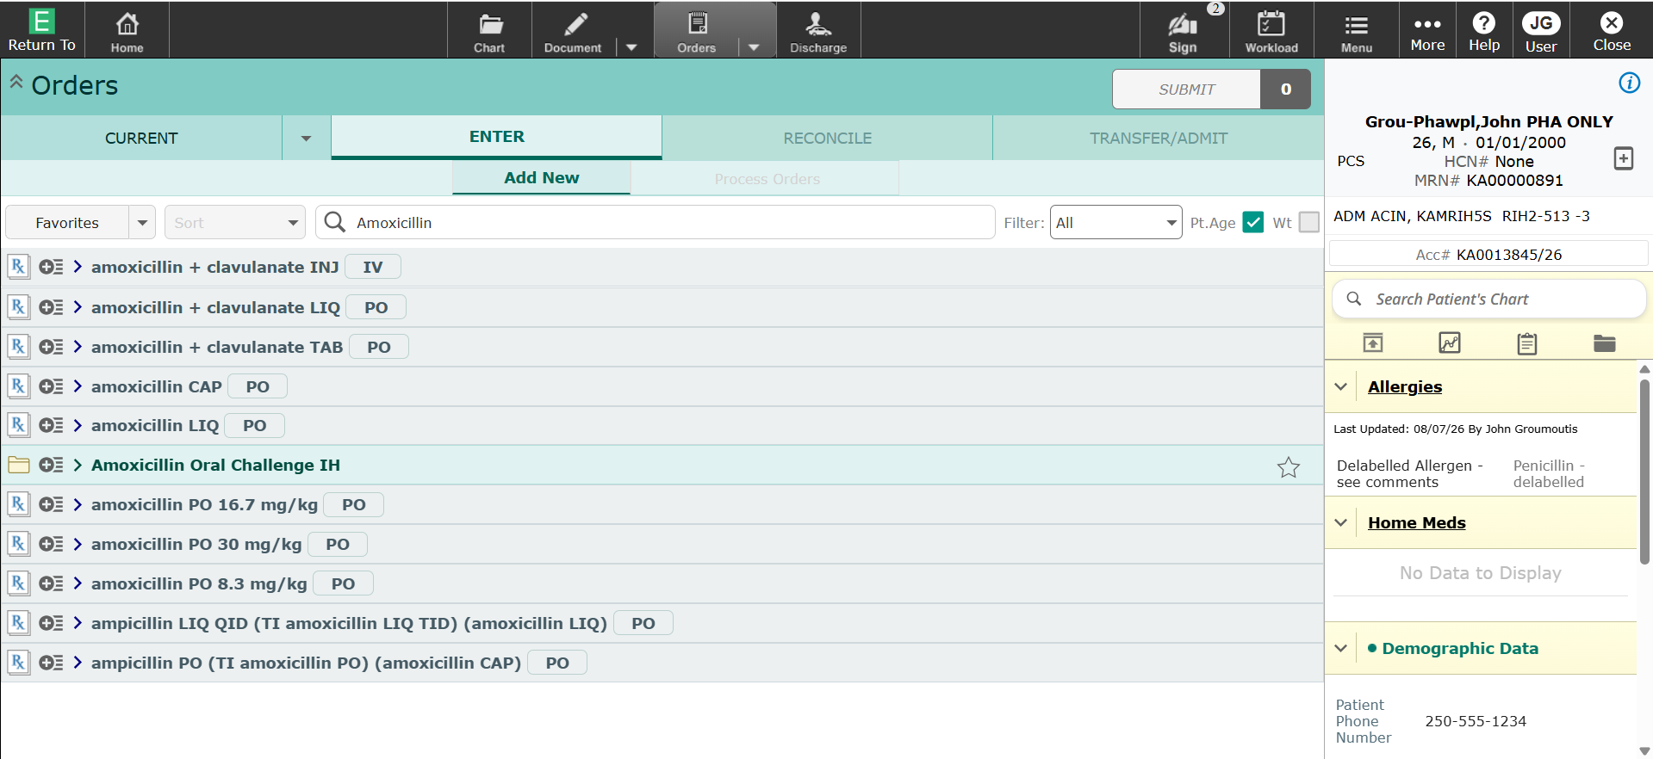


Slide 23
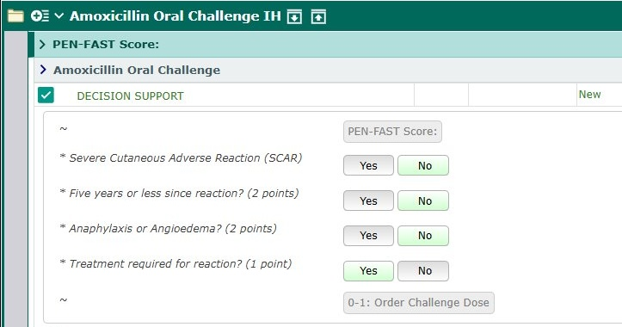

Slide 24
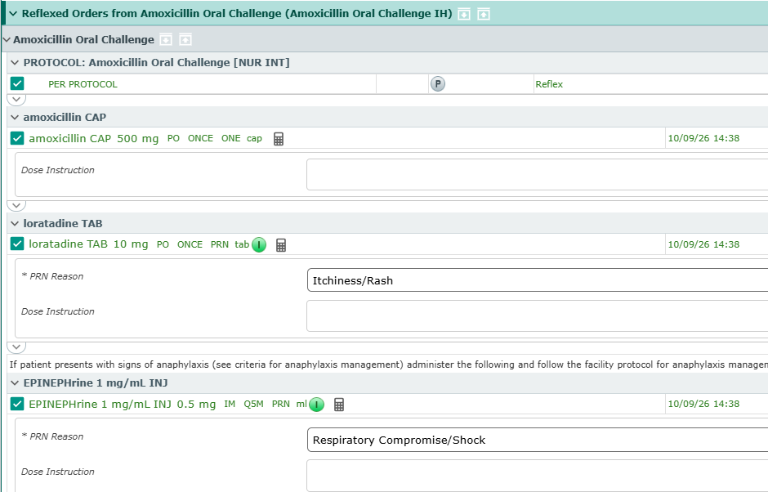

Slide 25

Patient Cases

Slide 26
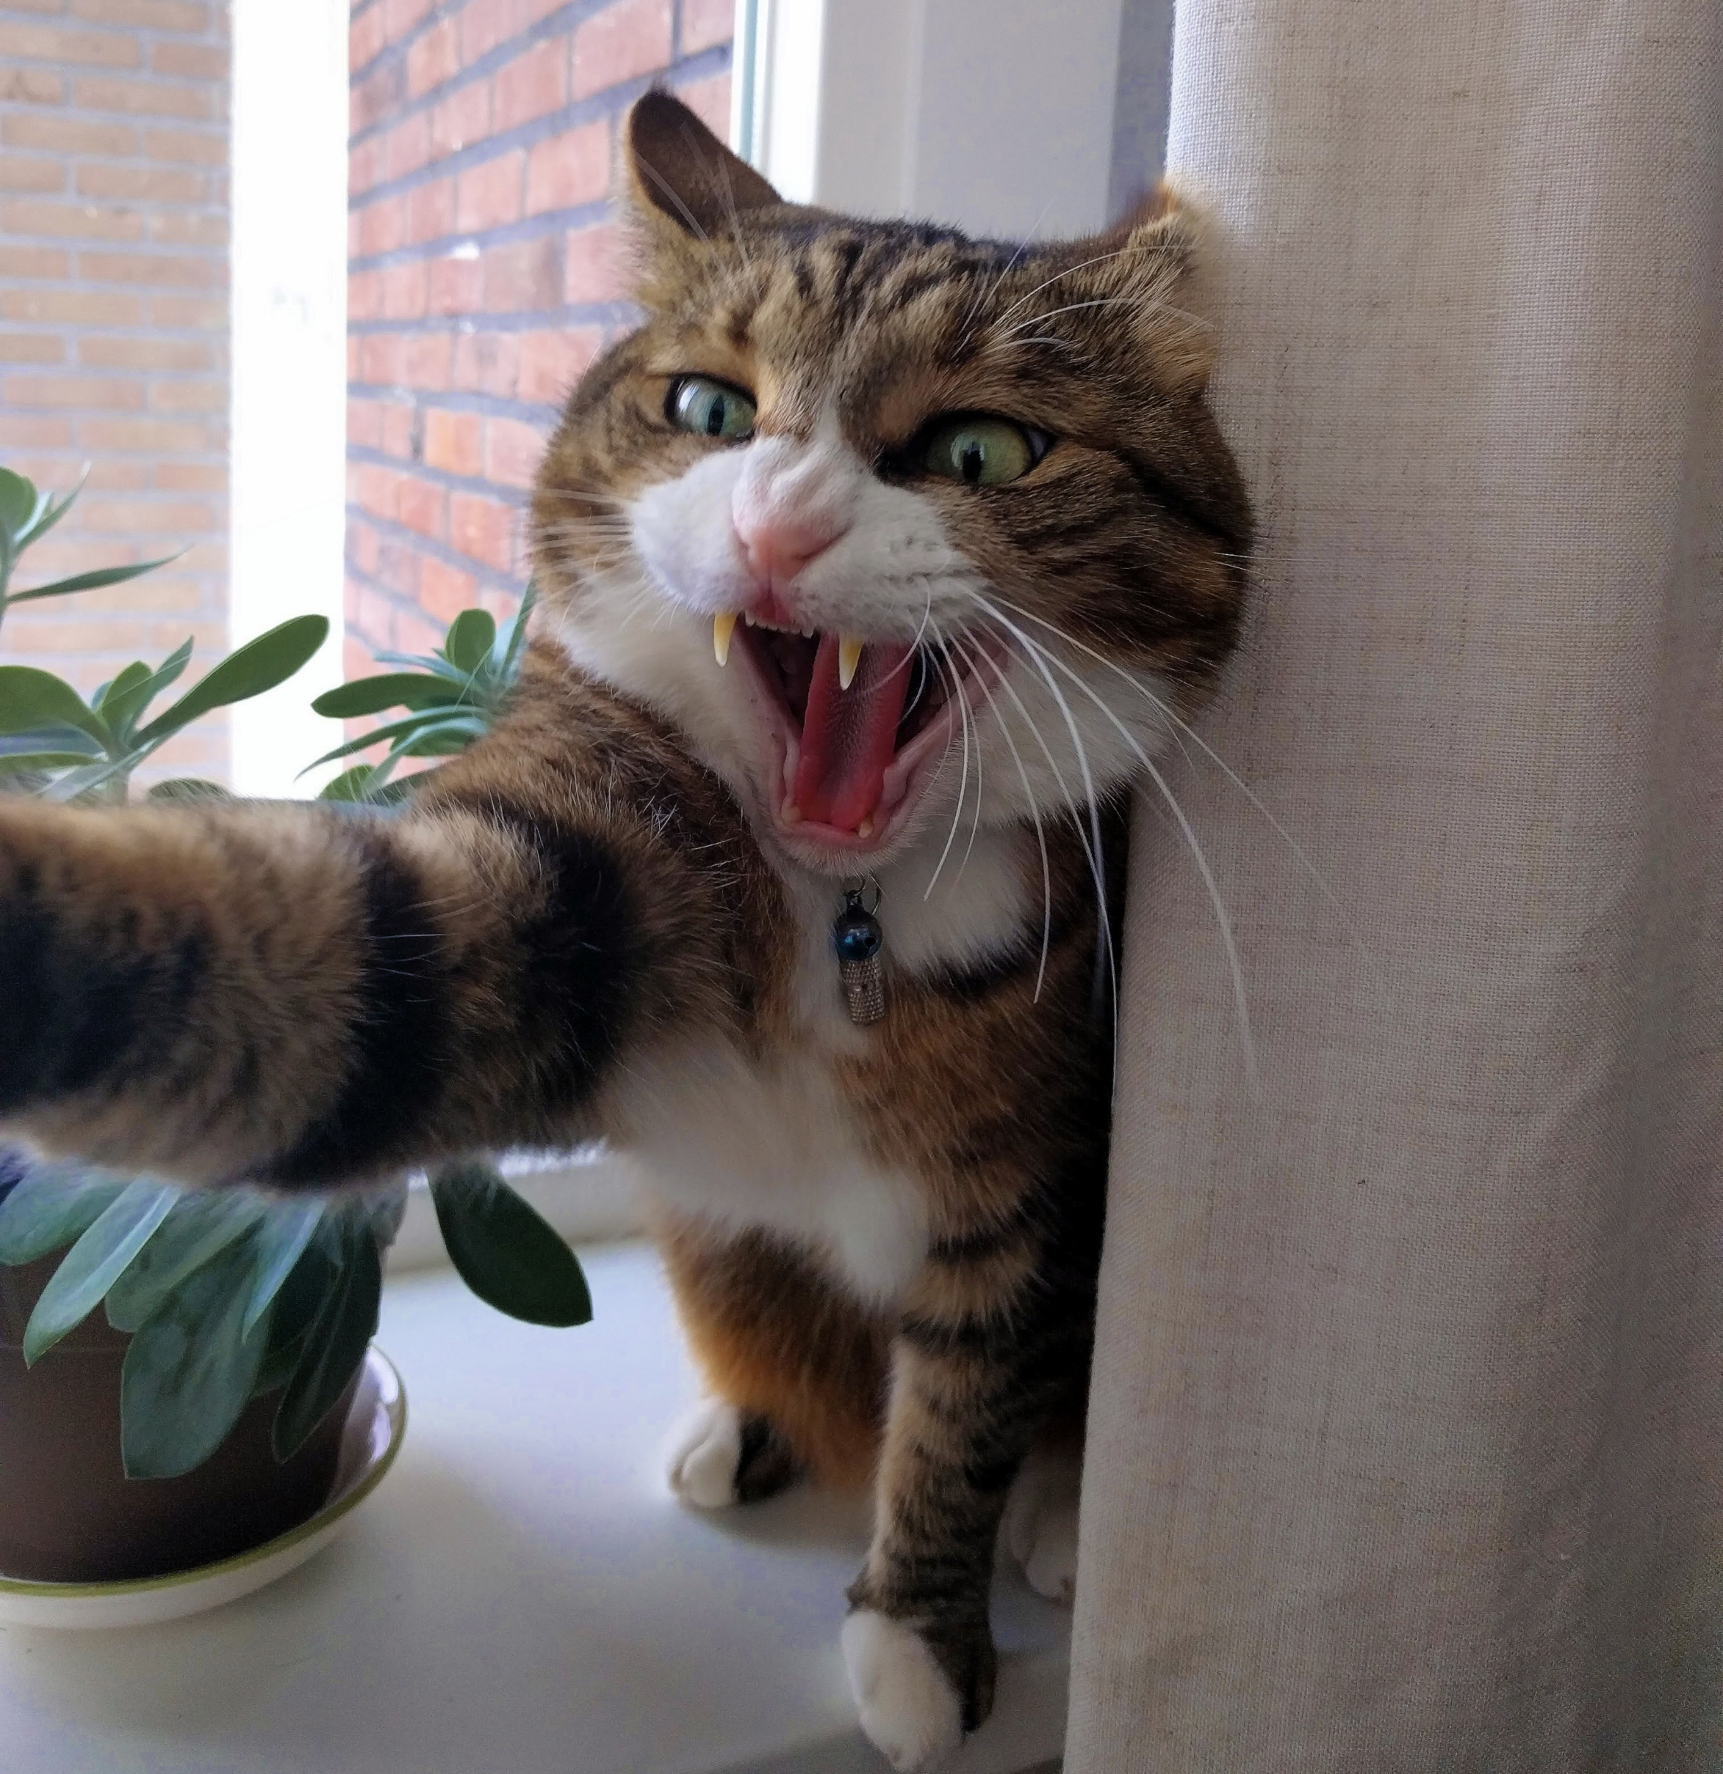
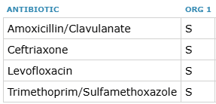
Case #1 – P. multocida bacteremia
75F admitted for Pasteurella multocida bacteremia secondary to left leg cellulitis. On Ceftriaxone
https://commons.wikimedia.org/wiki/File:Angry_cat_by_Juliet_van_Ree.jpg

Slide 27
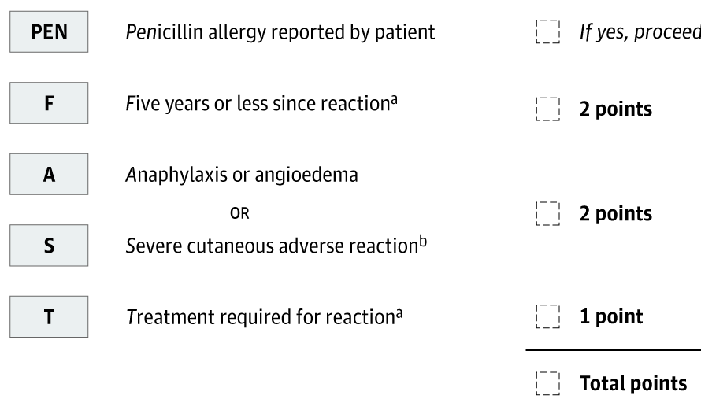
Penicillin allergy in Meditech:
(severe) rash
Occurred ~15y ago
Immediate-onset rash on chest
Denied other signs or symptoms
Resolved with d/c of penicillin; no treatment required
What is her PEN-FAST score?
Is she eligible for a direct oral challenge?

Slide 28


Slide 30

Case #1
Received and tolerated Amoxicillin 500mg PO x 1
Stepped down to and discharged on Amoxi-clav to complete therapy
Counselled her to watch for any delayed-onset maculopapular rash
Image by Gemini

Slide 31
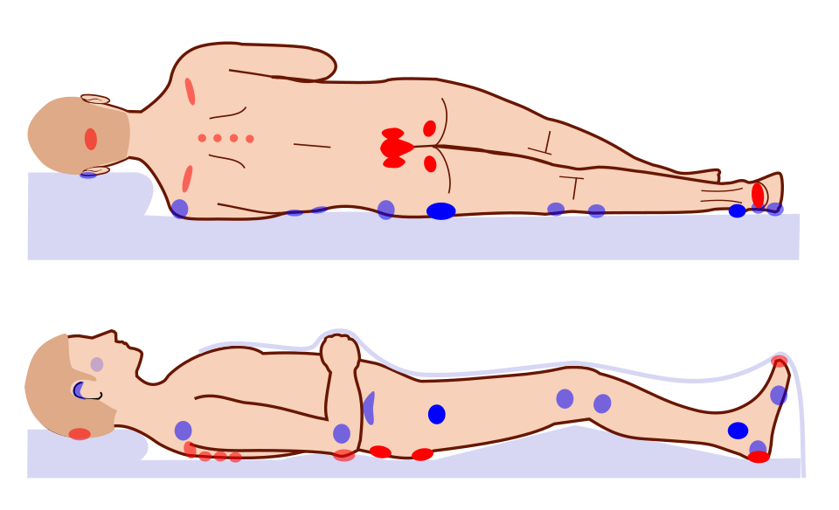
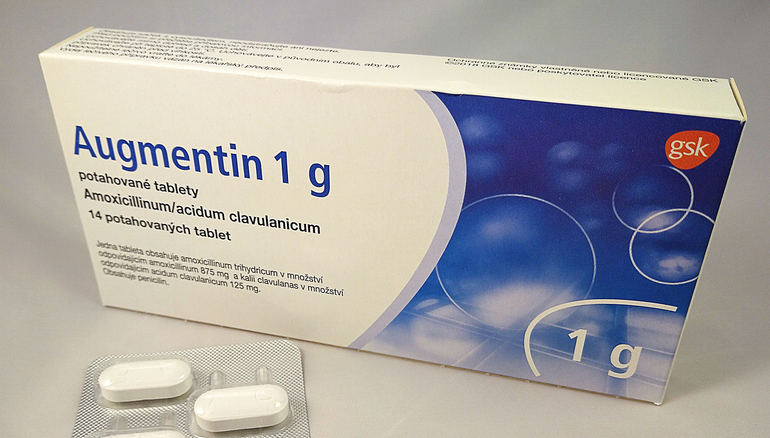
Case #2 – Sacral ulcer
47m, admitted with an infected sacral wound.
Sacral ulcer cultures now show mixed flora, E. coli, B. fragilis
Amoxi-clav would be convenient…
https://commons.wikimedia.org/wiki/File:Pressure_ulcer_points.svg
https://commons.wikimedia.org/wiki/File:Augmentin_1_g_tbl.jpg

Slide 32
Allergy: Penicillin (Severe) – Hives/Urticaria
Reacted as a teenager (~30y ago)
Immediate-onset hives
Does not recall angioedema, dyspnea, loss of consciousness
No treatment received

Slide 33
Reacted as a teenager (~30y ago)
Immediate-onset hives
Does not recall angioedema, dyspnea, loss of consciousness
No treatment received
What is his PEN-FAST score?
Is he eligible for a direct oral challenge?

Slide 35


Slide 36

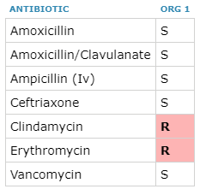
Case #3 – Clindamycin Troubles
84f, admitted for submental space infection secondary to mandibular osteomyelitis.
  Received 9 courses of clindamycin in past 14 months
OR for incision, drainage, debridement, and sequestrectomy.
Ceftriaxone + Metronidazole
OR cultures positive for Strep Anginosus
Image by Gemini

Slide 37
Allergies: Penicillin V + Amoxicillin – Rash
Recalls taking amoxicillin ~4 years ago
Developed non-pruritic rash within a day on her upper body
Denied severe symptoms (mucocutaneous involvement, skin peeling or blistering)
Stopped the amoxicillin and the rash self-resolved
Did not require treatment for the reaction

Slide 38
Recalls taking amoxicillin ~4 years ago
Developed non-pruritic rash within a day on her upper body
Denied severe symptoms (mucocutaneous involvement, skin peeling or blistering)
Stopped the amoxicillin and the rash self-resolved
Did not require treatment for the reaction
What is her PEN-FAST score?
Is she eligible for a direct oral challenge?

Slide 39


Slide 40


Slide 41
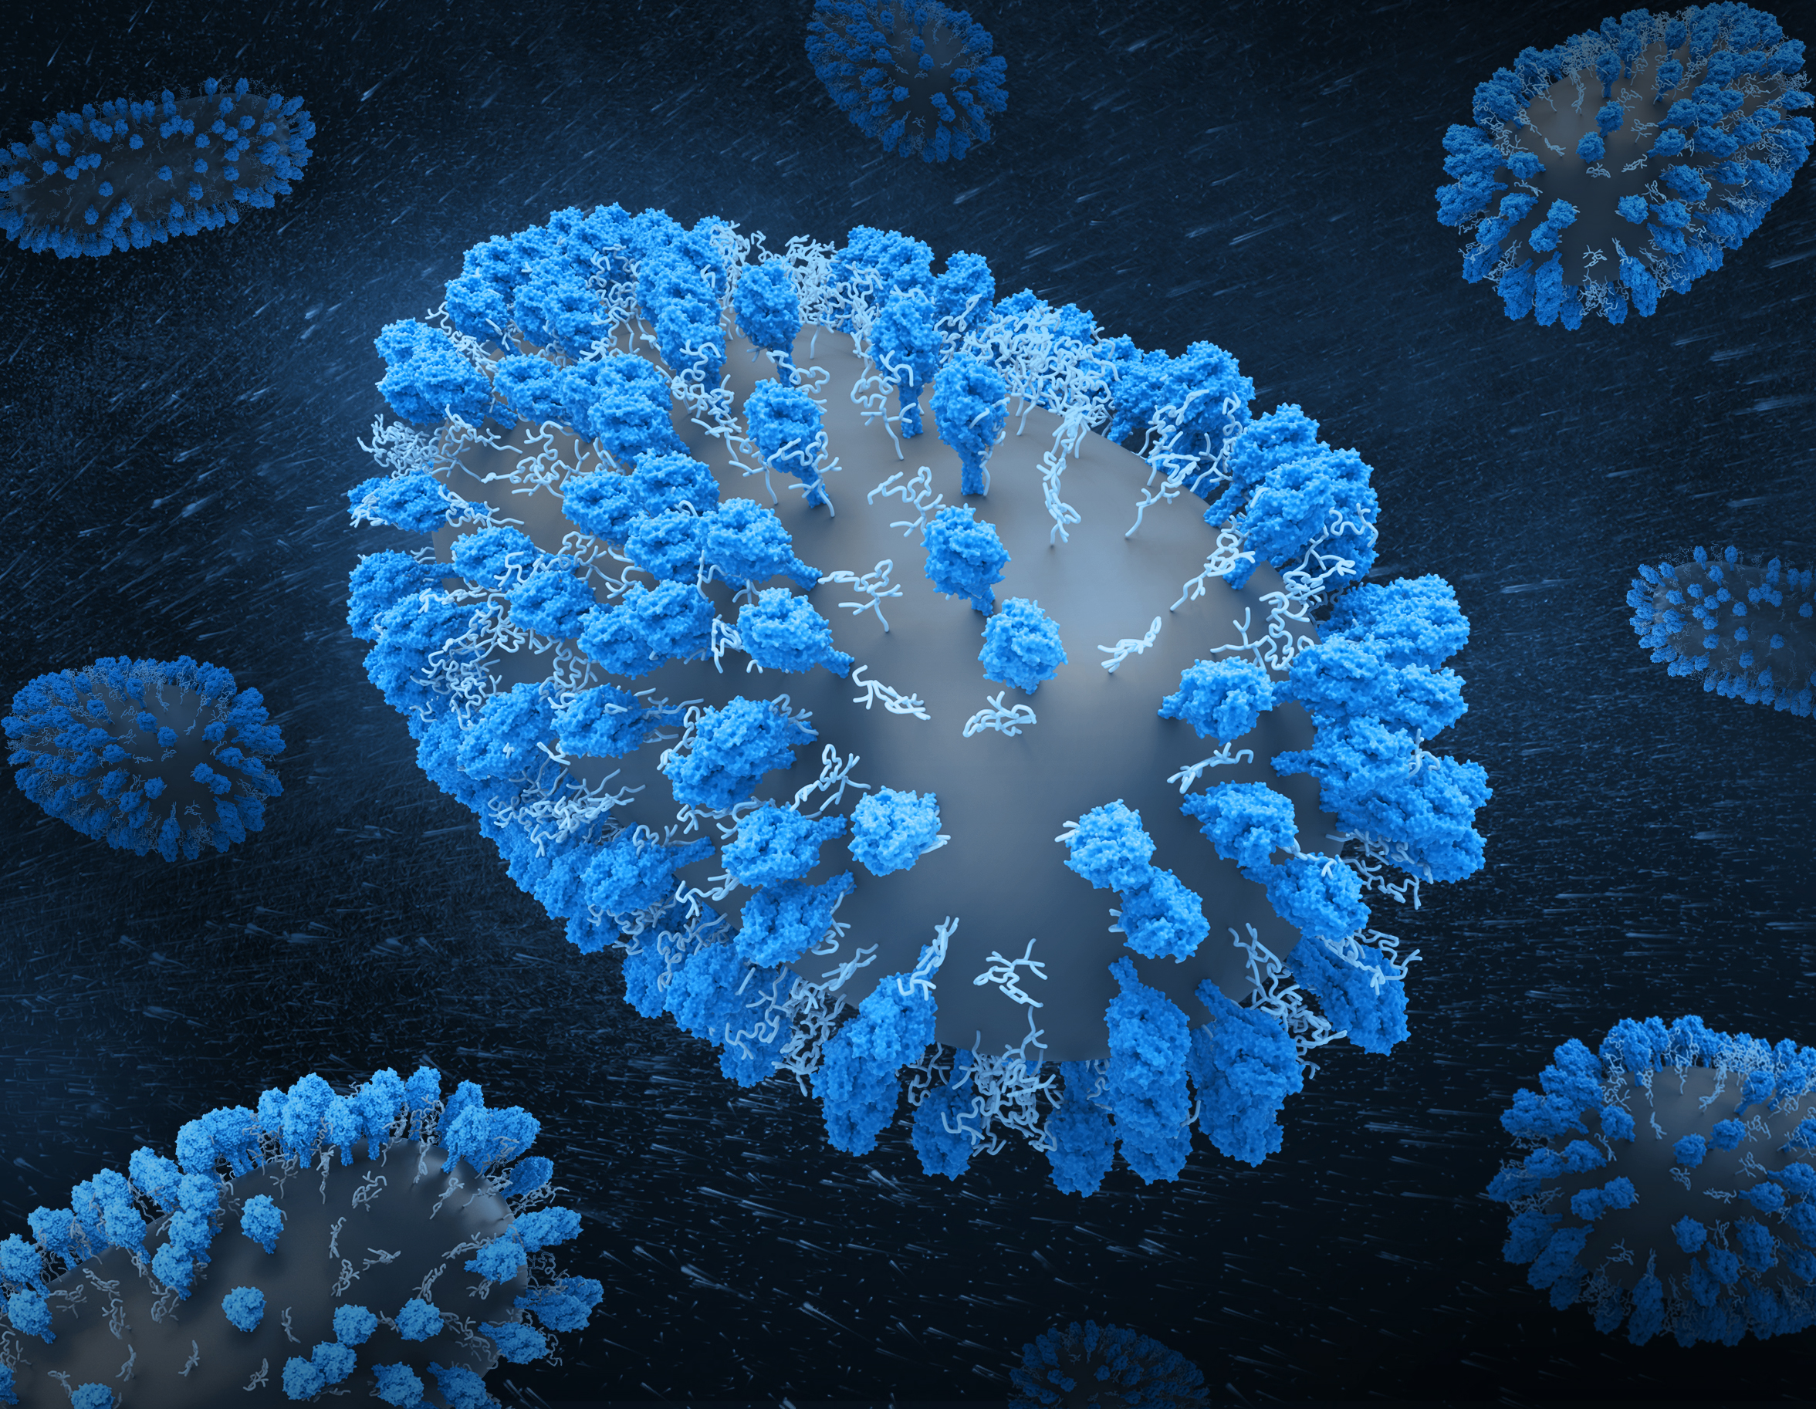
Case #4 - ?GI Symptoms
90F, admitted with URTI found to be RSV+.
Penicillin – Allergy – GI symptoms
Used to tolerate amoxicillin
In the Fall of 2023 was prescribed a course for chest infection and developed immediate itchy rash and felt dizzy
Denied swelling or dyspnea
Happened again on subsequently trying another dose
Self-resolved without treatment
https://commons.wikimedia.org/wiki/File:Human_Respiratory_Syncytial_Virus_%28RSV%29_-_3111.jpg

Slide 42
Used to tolerate amoxicillin
In the Fall of 2023 was prescribed a course for chest infection and developed immediate itchy rash and felt dizzy
Denied swelling or dyspnea
Happened again on subsequently trying another dose
Self-resolved without treatment
What is her PEN-FAST score?
Is she eligible for a direct oral challenge?

Slide 43
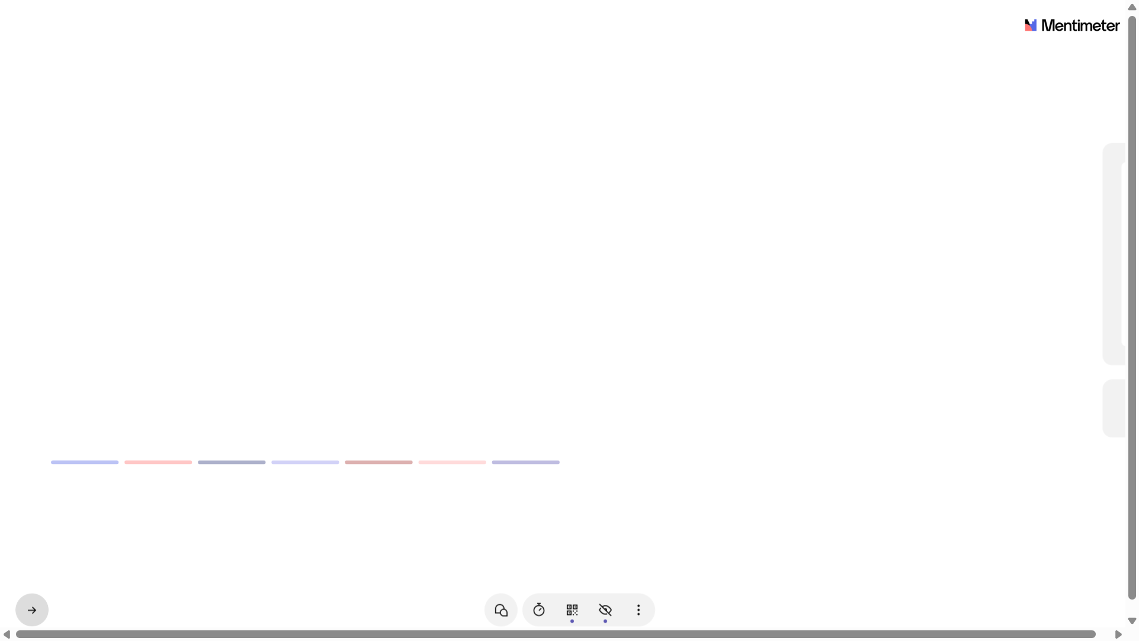

Slide 44
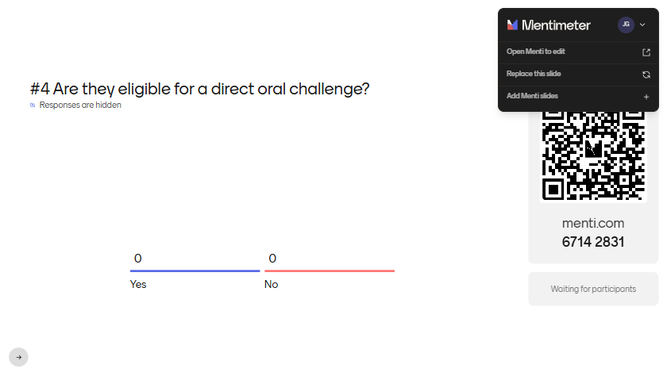

Slide 45

Case #5 – Forget the Details
54F, post-drainage of retropharyngeal abscess.
On Ceftriaxone + Metronidazole
Allergy: Penicillins – Unknown
Was told since she was a child she was allergic but does not recall any reaction. Does not recall ever being told of having had a serious reaction requiring hospitalization/treatment

Slide 46
Was told since she was a child she was allergic but does not recall any reaction. Does not recall ever being told of having had a serious reaction requiring hospitalization/treatment
What is her PEN-FAST score?
Is she eligible for a direct oral challenge?

Slide 47


Slide 48
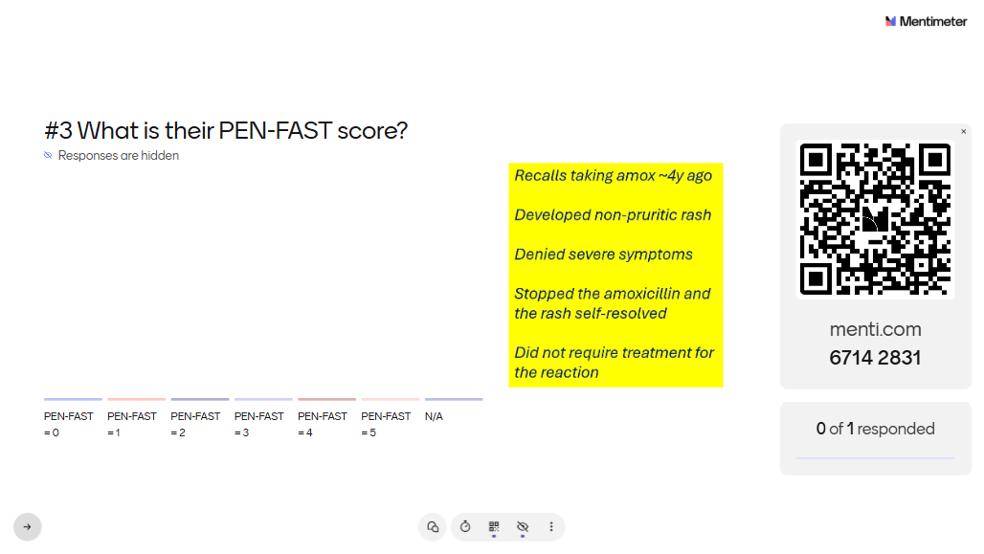

Slide 49

Delabelling
Steps
https://commons.wikimedia.org/wiki/File:Questionnaire-checklist.png

Slide 50
Educate the patient!
Remove the allergy record from local EMR (ex. Meditech)
Communicate the update to other care providers (eg. GP, community Rx)
Remove the allergy record from Pharmanet (if needed)
  Request to Inactivate Adverse Reaction/Clinical Condition on Pharmanet Profile (https://www2.gov.bc.ca/assets/gov/health/forms/5550fil.pdf)

Slide 51
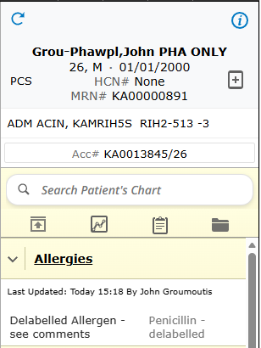
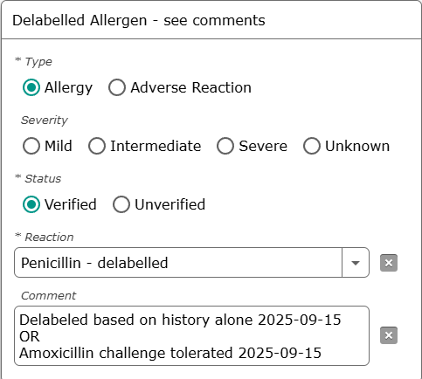
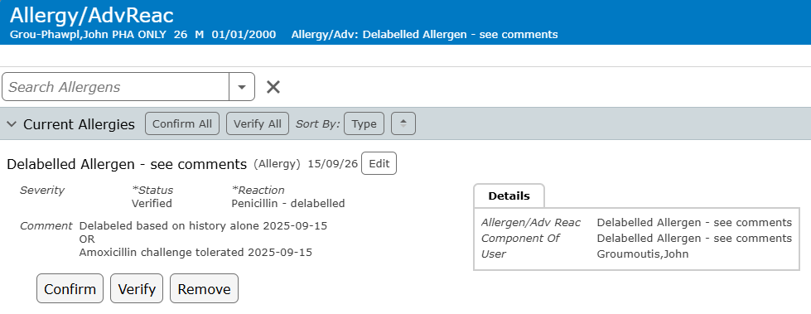
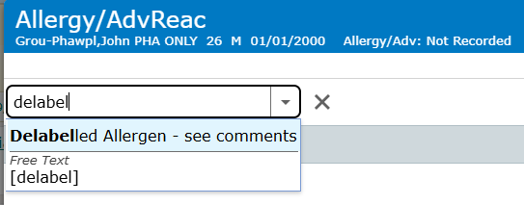
Add Delabelled Allergen Tag in Meditech!

Slide 52
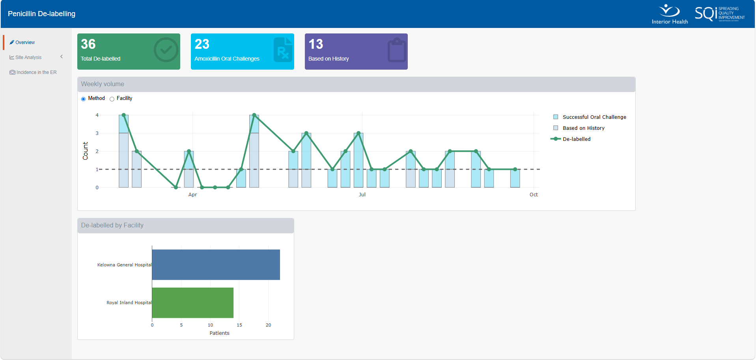
IH SQI Team is Tracking the Data
https://sqi-ih.shinyapps.io/pen_de-labelling/
Notes:
Dashboard as of Oct 2, 2026

Slide 53

Resources
https://commons.wikimedia.org/wiki/File:Resources_icon.png

Slide 54
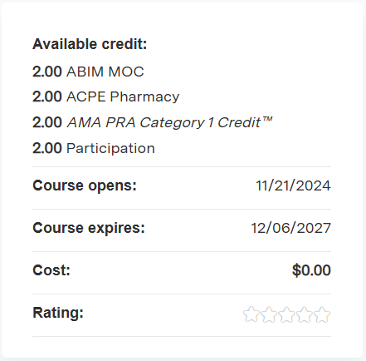

Society for Healthcare Epidemiology of America (SHEA)
https://learningce.shea-online.org/content/penicillin-allergy-management-removing-barriers-optimal-antibiotic-prescribing#group-tabs-node-course-default1

Slide 55

https://www.dropthelabel.ca/

Slide 56

SULF-FAST
CEPH-FAST
JAMA Netw Open. 2023 Jun 1;6(6):e2316776
JAMA Netw Open. 2025 Jul 1;8(7):e2519113
J Infect. 2025 Jun;90(6):106495
https://ru.pinterest.com/pin/1088111959973893439/

Slide 57
Questions?
john.groumoutis@interiorhealth.ca

