Slide 1

Hypertensive Disorders of
Pregnancy (HDOP) and Long-term
Effects on Women’s Health:
Why We Should Care And What We Can Do About It
Dr. Mary Malebranche MD FRCPC
General Internal Medicine/Obstetric Medicine
Division of General Internal Medicine
Assistant Professor, Faculty of Medicine, UBC
RIH CME Series
April 9, 2024

Slide 2
Land acknowledgment
The RIH MSA recognizes we work, live, and play in the Tk’emlups te Secwepemc territory within the unceded traditional lands of the Secwepemc Nation and home of the Two Rivers Metis Society. As such, we give thanks and acknowledge the significance of Secwepemcul’ecw as integral in the path to health and healing.

Slide 3
Presenter Disclosure
Faculty: Dr. Mary Malebranche
Relationship with financial sponsors: None to declare
Potential conflicts of interest: None to declare

Slide 4
Objectives
What are hypertensive disorders of pregnancy (HDOP)? An overview
  Classification of HDOP
  Brief overview of placental physiology and pathophysiology
  Clinical risk factors for HDOP
Why should we care?
  HDOP and their relevance across the lifespan
    Notably long-term CV and renal health outcomes
What can we do about it?

Slide 5
Bit about me…
GIM Subspecialty fellowship: University of Ottawa – 2014-2017
  R4 year – Ottawa: GIM
  R5 year – Toronto: Obstetric Internal Medicine, Mount Sinai Hospital
GIM/OBIM staff:
  University of Calgary – 2017-2019
  Dalhousie University – 2020-2022
  UBC/Royal Inland Hospital – 2022 - present

Slide 6
What are hypertensive disorders of pregnancy?
Classification of HDOP

Slide 7
Classification of hypertensive disorders of pregnancy (HDOP)
Disorder | Comment
Pre-existing (chronic) hypertension | Develops either pre-pregnancy or at <20 weeks gestation
Gestational hypertension | Develops for the first time at >20 weeks gestation
Preeclampsia | May arise “de novo” or be “superimposed” on pre-existing or gestational hypertension Defined as hypertension with one or more of: New proteinuria, OR One or more adverse conditions*, OR One or more severe complications
Other hypertensive effects Transient hypertension White coat hypertension Masked hypertension | These may occur in women whose BP is elevated at any point in pregnancy who are suspected of having pre-existing or gestational hypertension.
JOGC 2014

Slide 8
Classification of hypertensive disorders of pregnancy – Preeclampsia
Defined as hypertension with one or more of:
  New proteinuria, OR
  One or more adverse conditions*, OR
  One or more severe complications*
Proteinuria:
≥0.3 g in a 24-hour urine specimen
≥0.3 mg/mg (30 mg/mmol) in urine PCR
dipstick ≥2+ if quantitative measurement
unavailable
Organ system affected | Examples of adverse conditions | Examples of severe complications
CNS | Headache/visual symptoms | Eclampsia, PRES, TIA/Stroke
Cardiorespiratory | Chest pain/dyspnea | Uncontrolled severe hypertension
Hematologic | Thrombocytopenia | Severe thrombocytopenia
Renal | elevated creatinine | AKI
Hepatic | RUQ/epigastric pain, Transaminitis | Hepatic dysfunction
Feto-placental | Abnormal FHR, IUGR, oligohydramnios | Placental abruption, stillbirth

Slide 9
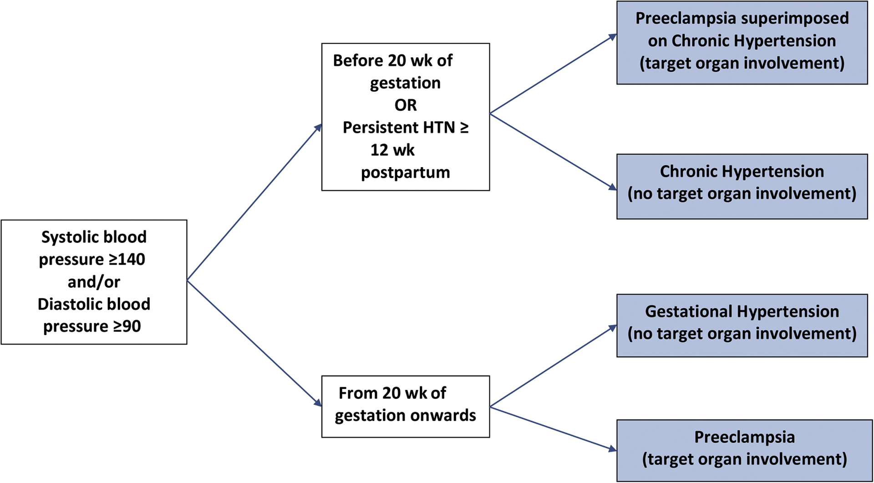
Classification of hypertensive disorders of pregnancy
Hypertensive disorders of pregnancy, Cardiol Clin Feb 2021

Slide 10
What are hypertensive disorders of pregnancy?
Brief overview of placental physiology and pathophysiology

Slide 11
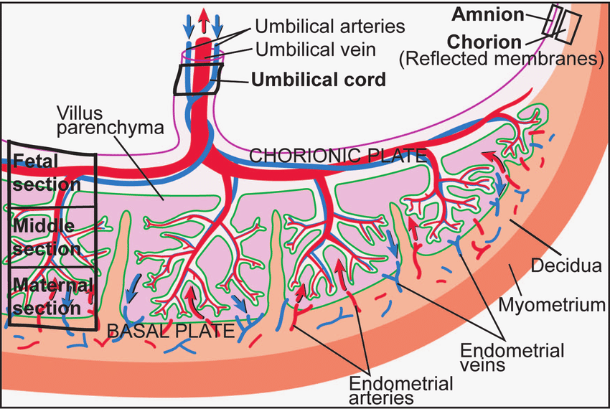
Placental physiology - brief overview of “normal”
https://www.pnas.org/doi/10.1073/pnas.0508035103

Slide 12
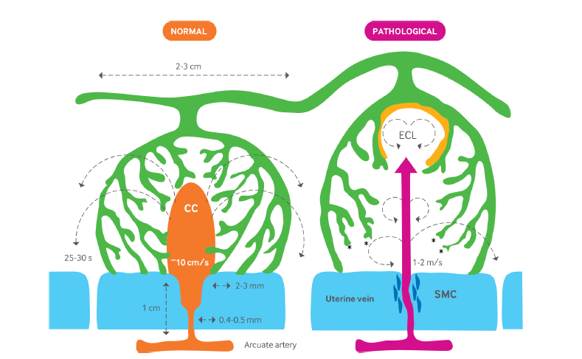
Placental pathophysiology in HDOP - brief overview of ”abnormal”
Low velocity of incoming blood (10 cm/s)
Even distribution of blood flow between villi
Optimal time for oxygen exchange
High, jet-like spurts of incoming blood (100 cm/s)
Uneven, turbulent distribution of blood flow between villi causes damage to villi
Impaired oxygen exchange
Retention of smooth muscle around spiral artery
CC = central cavity, ECL = echogenic cystic lesion, SMC = smooth muscle cells
Burton, et al. Pre-eclampsia: pathophysiology and clinical implications. BMJ 2019
Notes:
echogenicFig 3 | Diagrammatic representation of the effects of spiral artery remodeling on the inflow of maternal blood into the intervillous space in normal and pathological
pregnancies. Dilation of the distal segment of the spiral artery in normal pregnancies reduces the velocity of incoming blood, and the residual momentum carries
the blood into the central cavity (CC) of a placental lobule, from where it disperses evenly between the villi. Transit time to the uterine vein is estimated to be in the
order of 25-30 s, allowing adequate time for oxygen exchange. In pathological pregnancies, where no or very limited conversion occurs, the maternal blood enters
the intervillous space in a jet-like spurt at speeds of 1-2 m/s. Flow is likely to be turbulent, indicated by the circular arrows, and the high momentum damages the
villi, forming echogenic cystic lesions (ECL) lined by thrombus (stippled). The transit time will be reduced, so that oxygen exchange is impaired. Trophoblastic
microparticulate debris may be dislodged from the villous surface. The retention of smooth muscle cells (SMC) around the spiral artery will increase the risk of
spontaneous vasoconstriction and ischemia-reperfusion injury (Modified from48 with permission)

Slide 13
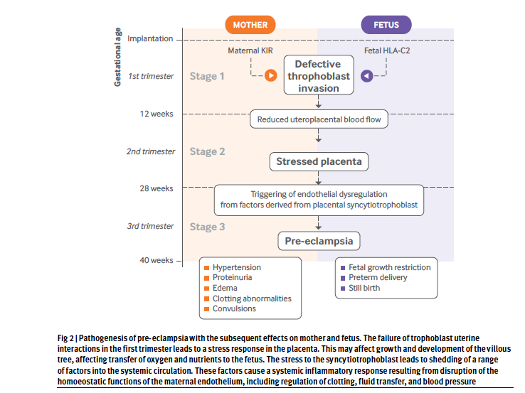
Placental pathophysiology in HDOP - brief overview of ”abnormal”

Slide 14
Placental pathophysiology in HDOP - brief overview of ”abnormal”

Slide 15
What are hypertensive disorders of pregnancy?
Clinical risk factors

Slide 16
Clinical factors associated with increased risk for developing HDOP/pre-eclampsia
MATERNAL FACTORS:
  Age <18 or >40
  Low SES or belonging to minority racial or ethnic group
  Chronic hypertension
  Chronic kidney disease
  Autoimmune disease (APLAS, SLE)
  Diabetes
  Obesity
  Vascular disease
  Family history of pre-eclampsia
OBSTETRIC FACTORS:
  Nulliparity
  multifetal gestation
  IVF
  Previous pre-eclampsia
  Previous IUGR, abruption or fetal demise
  Prolonged interpregnancy interval (>5 yrs)
  Short interpregnancy interval (if PET in previous pregnancy)
MALE PARTNER RELATED FACTORS:
  New male partner
  Limited sperm exposure (e.g. Previous use of barrier protection)

Slide 17
Why We should care
HDOP and their relevance across the lifespan

Slide 18
Why we should care
Poon et al. Int J Gynecol Obstet 2023

Slide 19
Why we should care
Poon et al. Int J Gynecol Obstet 2023

Slide 20
Long-term Cardiovascular Effects
Pregnancy is considered a cardiovascular stress test
When the normal CV adaptations do not occur during pregnancy, it seems to unmask physiological susceptibility to and risk for future CVD
It is also suspected that HDOP contributes to future CVD
Pregnancy and the postpartum period provide a unique window of opportunity to estimate a woman’s lifetime CV risk and engage in active early intervention

Slide 21
Meta-analysis in 2020, involving more than 13 million women, confirmed that those with a history of HDOP have 2x the risk of long term CVD-related morbidity and mortality.
73 studies in total
  66 cohort studies
  7 case control studies
  Large variance in sample sizes (N = 40 – 2,066,230)
  Year of publication was between 1995 – 2019 (58% published from 2010-2019)
  Europe (60%), North America (21%), Asia (9%), South America (3%), Oceania (1.5)
  Mean age 25-75
  Mean follow-up time from 0-42 years.
Wu et al, Cardiology 2020

Slide 22
Compared to normotensive women, women with HDOP were at higher risk for developing:
  Chronic hypertension (RR 3.16)
  Coronary artery disease (RR 1.66)
  Congestive heart failure (RR 2.87)
  Peripheral vascular disease, including VTE (RR 1.6)
  Stroke (RR 1.73)
  CVD related mortality (RR 1.78)
Wu et al, Cardiology 2020

Slide 23
Long-term Cardiovascular Effects
This effect does vary by specific pregnancy and individual characteristics
Different phenotypes of HDOP
  early onset pre-term pre-eclampsia (<34 weeks GA)
  Pre-term pre-eclampsia (34-37 weeks GA)
  Term pre-eclampsia (between 37-41 weeks gestational age)
  Postpartum pre-eclampsia
  E.g. the earlier the onset of pre-eclampsia the higher burden of CVD related morbidity and mortality in later years
Having 1 or more subsequent normotensive pregnancies reduces future CVD risk
American Heart Association and American Stroke Association now recognize HDOP as female specific risk factors for CVD, including stroke.

Slide 24
Other associated long-term effects
Chronic kidney disease (CKD)
  women with gestational hypertension
      1.5 fold increase risk for CKD
      2 fold increase risk for ESRD
  Women with pre-eclampsia
      2 fold increase risk for CKD
      5 fold increased risk for ESRD
Cognitive health
  Women with previous pre-eclampsia, particularly eclampsia, experience:
    poorer cognitive function for months to years after pregnancy
    3-4 fold increased risk for dementia later in life, particularly vascular dementia
Poon et al. Int J Gynecol Obstet 2023

Slide 25
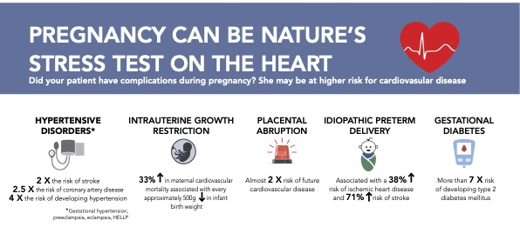
Graves, et al. Canadian Family Physician, Dec 2019

Slide 26
What We can we do about it
Interventions for minimizing medium to long-term effects on women’s health

Slide 27
Graves, et al. Canadian Family Physician, Dec 2019

Slide 28
What we can do about it
Currently available CVD risk calculators underestimate individual risk in the context of HDOP
  These women are young and have a low baseline risk in the next 10 years.
Basing clinical decisions on their “low risk” status at the time of their pregnancy (or postpartum) risks us missing this important opportunity for CV risk reduction

Slide 29
Intervening early to reduce lifetime risk
CV risk screening for women with HDOP should occur within the 1st year postpartum
AHA recommends that CV screening occur at 6 weeks, 12 weeks, 6 months and 12 months postpartum:
  BP measurement, BMI, lifestyle counselling
Benefits of early intervention:
  can potentially inhibit progression
  allows for early recognition and counselling re. CV risk factors
  Captive, motivated audience

Slide 30
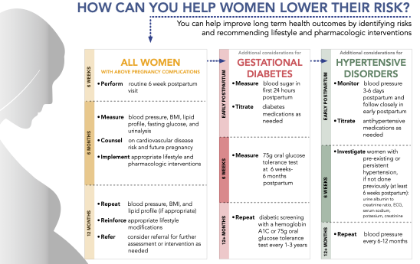
Graves, et al. Canadian Family Physician, Dec 2019

Slide 31
CVD risk factor follow-up – 1st year postpartum
Poon et al. Int J Gynecol Obstet 2023

Slide 32

Intervening early to reduce lifetime risk
Postpartum clinics focused on CV risk reduction:
The Maternal Clinic, Kingston General Hospital (Queen’s University)
    first of its kind in North America.
    designed by Dr. Graeme Smith, director of the clinician investigation program in the maternal-fetal medicine division
    The Maternal Health Clinic is available at 6 months postpartum to women.
The MotHERS Program™
Mothers' Health Education, Research & Screening

Slide 33
Intervening early to reduce lifetime risk
Postpartum clinics focused on CV risk reduction:
The Maternal Clinic, Kingston General Hospital (Queen’s University)
  The goals of the clinic are to:
    promote mothers' health
    screen for heart disease risk factors and,
    educate women on the links between pregnancy complications and heart disease.
  Focus on education and empowerment
  FIGO Best Practice paper (Int J Gynecol Obstet 2023), used this clinic as a Case Study outlining best practice
The MotHERS Program™
Mothers' Health Education, Research & Screening

Slide 34
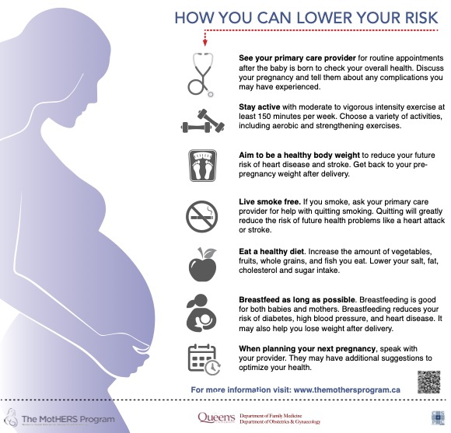
Graves, et al. Canadian Family Physician, Dec 2019

Slide 35
The Maternal Clinic – Mother’s Program
Postpartum HDOP Clinic, Halifax Infirmary, Dalhousie University
  Started in 2020
  Postpartum BP management
  CV risk counselling at 6 months postpartum
Dr. Kara Nerenberg, University of Calgary,
Heart & Stroke Mid-Career Women’s Heart and Brain Health Chair
  Has established a Canadian Post-Pregnancy Clinical Network, which connects 20 clinics across the country doing this work

Slide 36

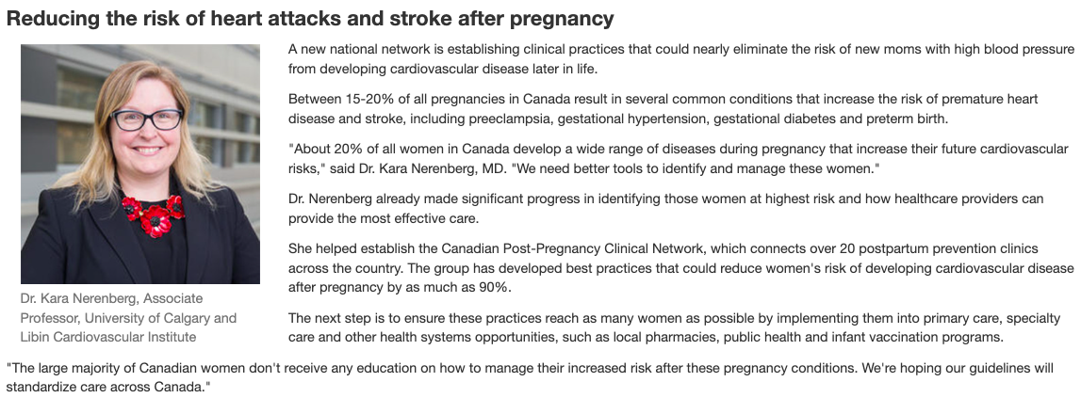

Slide 37
Intervening to minimize risk – longer term
Currently lacking evidence for the pharmacologic interventions postpartum to reduce longer term CV risk but studies underway:
  ASA
  Statin therapy
  Metformin
When a woman has had an HDOP, should care be initiated with a vision towards primary prevention or secondary prevention?

Slide 38
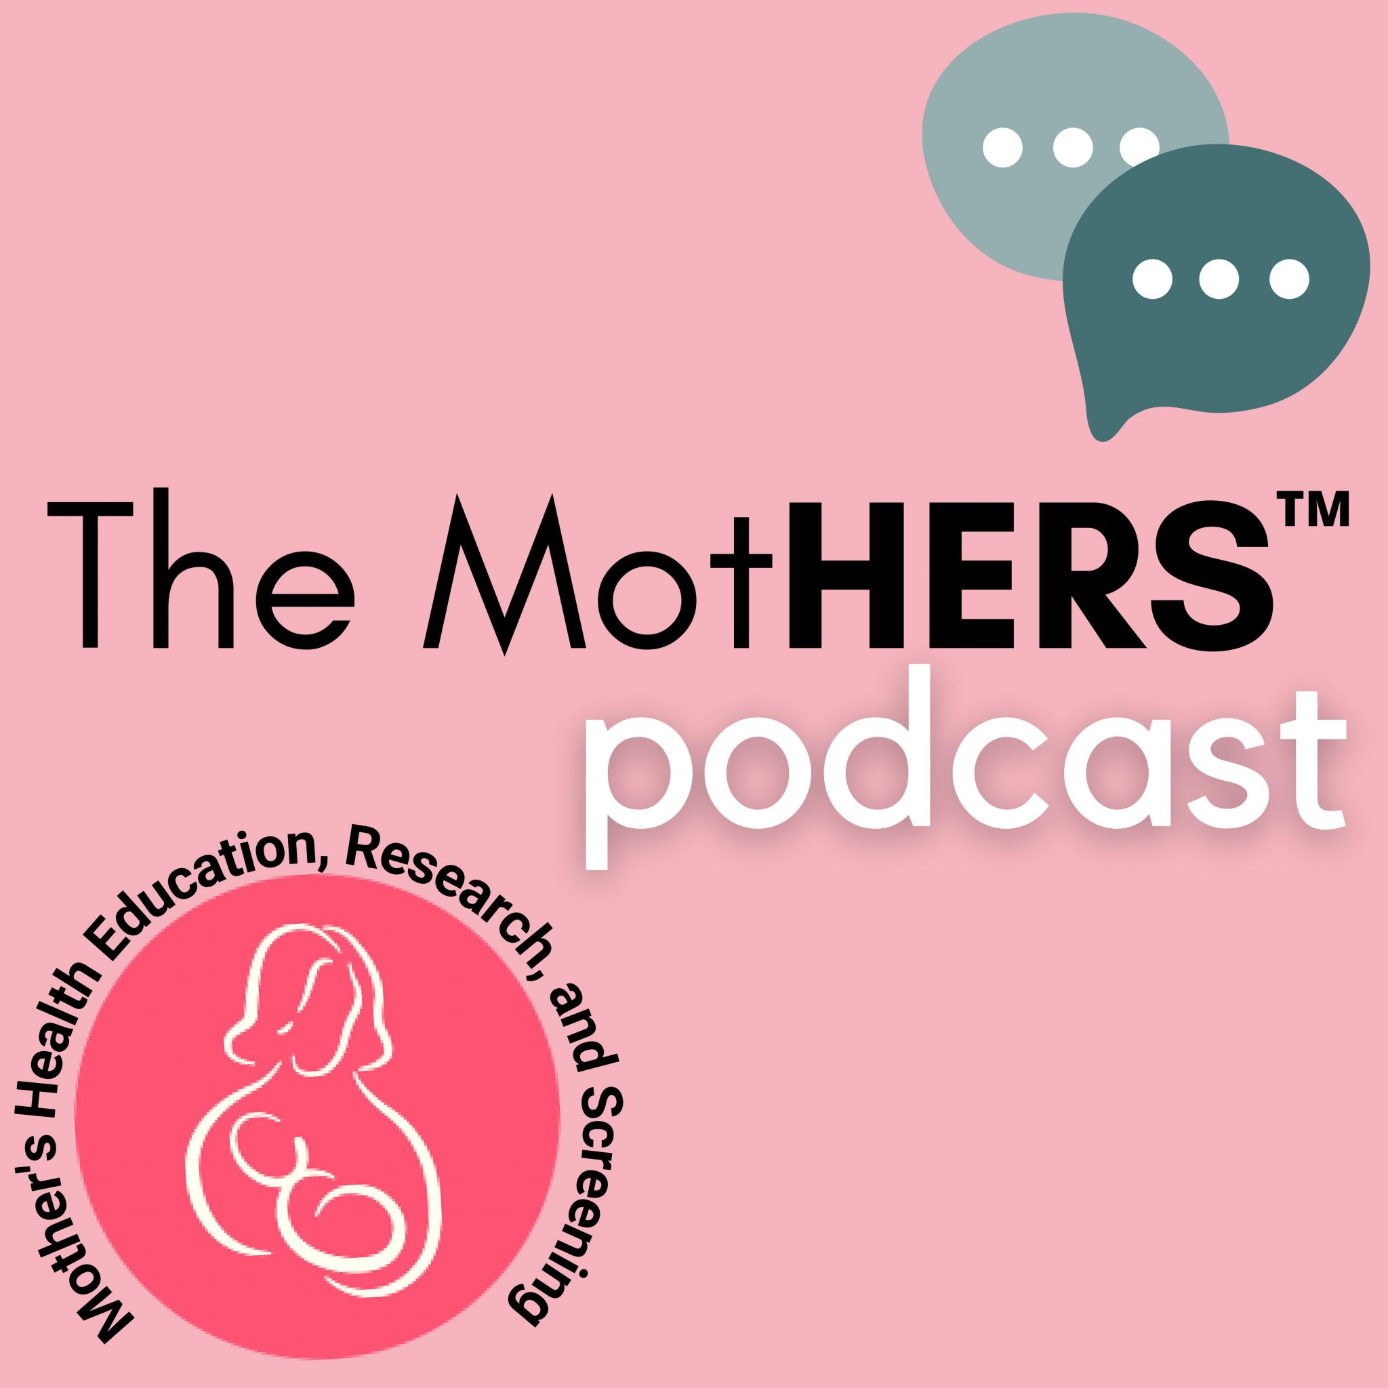
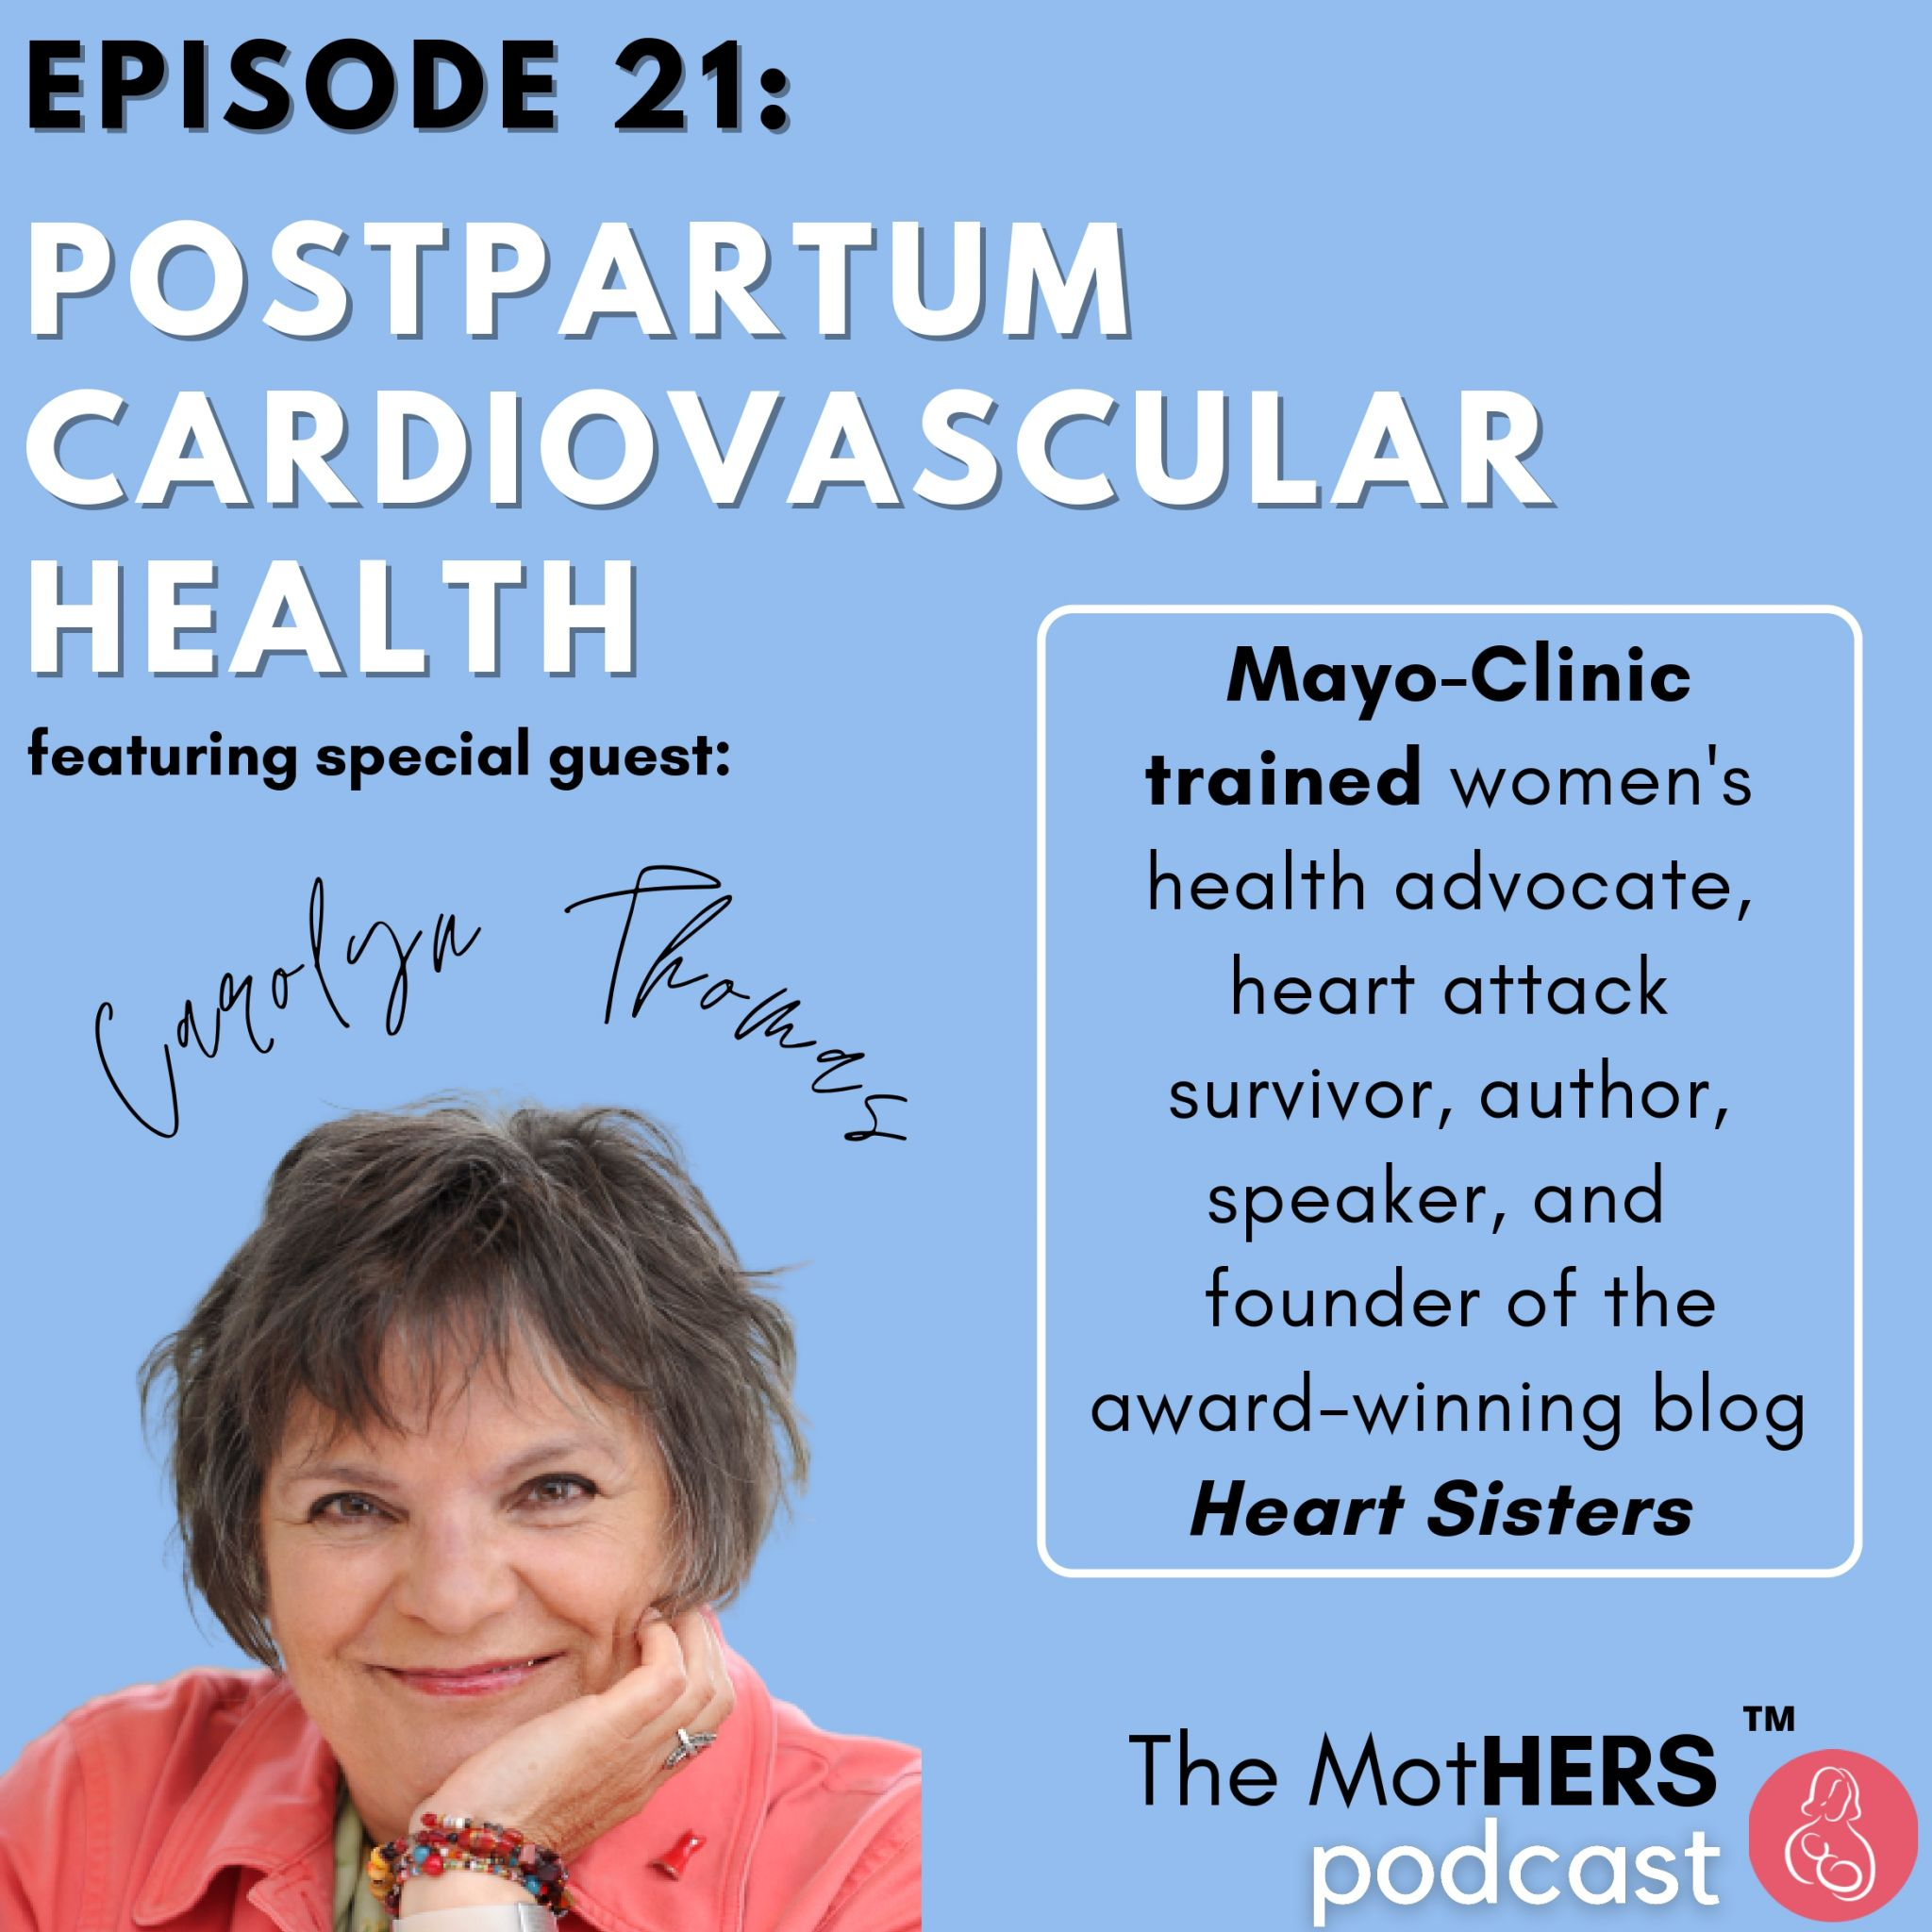

Slide 39
Visions for the future
Enrolling women with history of HDOP in VIP style clinic
Establishing CV risk counselling for women across Interior Health at 6 months postpartum (quite conducive to telehealth visits)
  Very rewarding work
  Proactive, upstream education to improve health literacy in young women with long runway for benefits of lifestyle changes

Slide 40
Hypertensive Disorders of
Pregnancy (HDOP) and Long-term
Effects on Women’s Health:
Why We Should Care And What We Can Do About It
Mary.Malebranche@interiorhealth.ca

