Slide 1
Proteinuria Management and Nephrology Update
David Nicholl, MD MSc FRCPC
Nephrologist, Royal Inland Hospital
March 12, 2024

Slide 2
Land Acknowledgement
I am fortunate to be speaking to you today from the traditional, ancestral and unceded territory of the Secwépemc as well as the Two Rivers Métis Society.

Slide 3
Faculty/Presenter Disclosure
Faculty: David Nicholl
Relationships with financial sponsors:
Honoraria: Bayer (April 2023)
Notes:
This slide must be visually presented to the audience AND verbalized by the speaker.

Slide 4
Disclosure of Financial Support
None.
Potential for conflict(s) of interest:
Dr. Nicholl has received an honorarium from Bayer whose product is being discussed in this program for participating in the Finerenone Advisory Board Meeting in April 2023 .
Bayer is the developer of finerenone (Kerendia) that will be discussed during this program
Notes:
This slide must be visually presented to the audience AND verbalized by the speaker.

Slide 5
Mitigating Potential Bias
Bayer had no input into the development of this presentation.
The speaker will only be referring to finerenone as part of the updated and published KDIGO guidelines.
Notes:
This slide must be visually presented to the audience AND verbalized by the speaker.

Slide 6
Objectives
To review the importance of proteinuria/albuminuria in CKD.
To review Nephrotic vs Nephritic Syndrome.
To provide an update on proteinuria management (KDIGO guidelines).
RAS Inhibitors, SGLT Inhibitors, Mineralocorticoid Receptor Antagonists, GLP1 Agonists
To introduce the Kidney Failure Risk Equation.

Slide 7
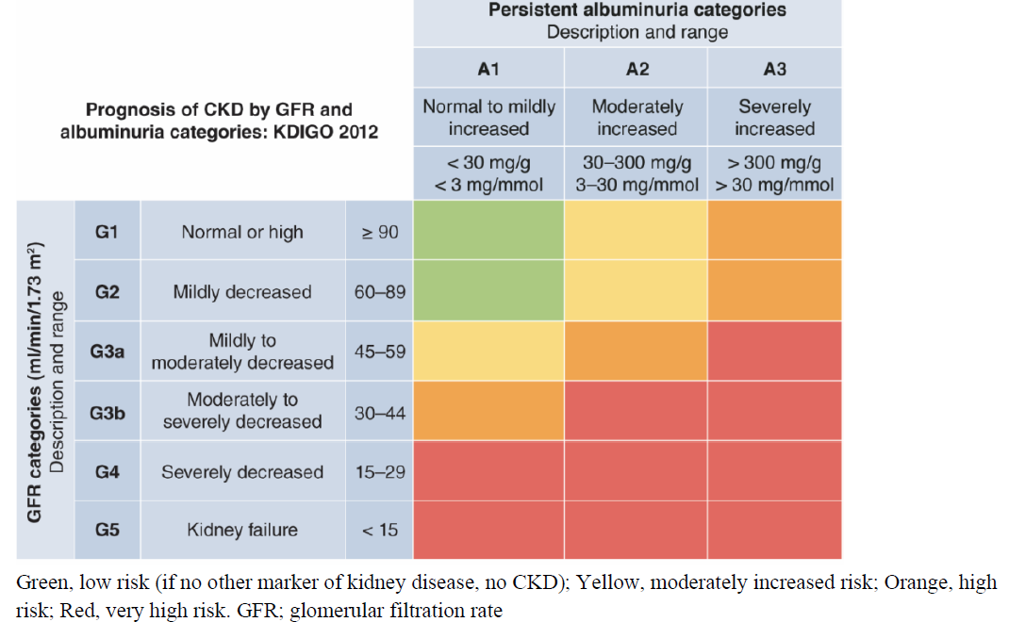
CKD is defined as abnormalities of kidney structure or function, present for > 3 months.
CKD is classified based on Cause, GFR category (G1-G5), and Albuminuria category (A1-A3), abbreviated as CGA.

Slide 8
Urine Normal Values
Urine Protein
Less than 150 mg/day
Urine Albumin
Less than 20-30 mg/day
Pregnancy
Less than 300 mg/day
Microscopic hematuria is abnormal
>2 RBCs per HPF on urine microscopy.

Slide 10
Why do we care about albuminuria?

Slide 13
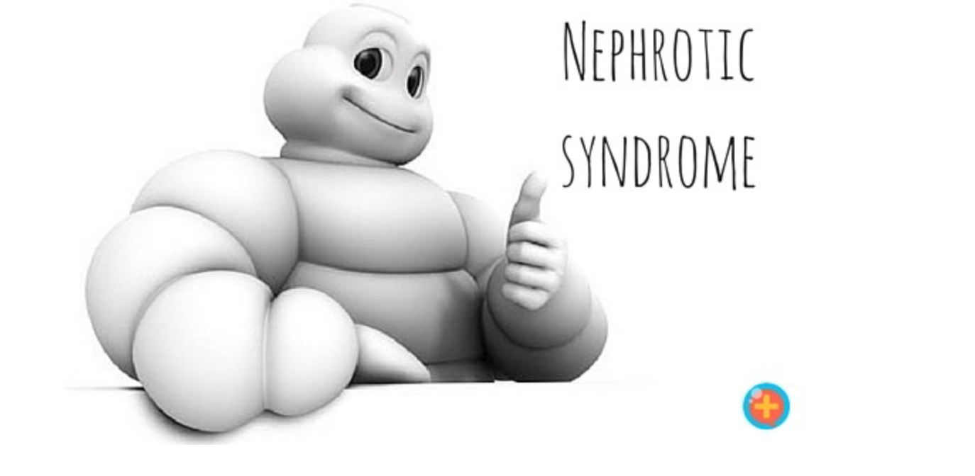
Nephrotic vs Nephritic Syndrome
Proteinuria
>3.5 g/day
Edema
Hypoalbuminemia
Dyslipidemia
Thromboembolism
Microhematuria
“Active” Urine Sediment
Dysmorphic RBCs, RBC Casts etc.
AKI
Hypertension
Nephrotic Syndrome is an Urgency – Nephritic Syndrome is a Medical Emergency!
If your patient has Nephritic Syndrome call Nephology!

Slide 14
Summary of Glomerular Disease
Glomerular Proteinuria (Benign)
Minimal Change Disease
FSGS
Membranous
Diabetes
Protein Deposition (Amyloid)
Nephrotic Syndrome
Isolated Glomerular Hematuria
Thin Basement Membrane Disease
IgA Nephropathy
Alport’s
“Active” Glomerular Hematuria
Anti-GBM Disease
Immune Complex GN
Pauci-immune GN (ie. ANCA)
Nephritic Syndrome
Mixed Active Glomerular Hematuria & Nephrotic Range Proteinuria
SLE
MPGN
Post-infectious GN
*Caveat IgA and SLE can do anything

Slide 15
Nephrotic Syndrome
Renal – Primary vs Secondary
Minimal Change Disease
FSGS
Membranous Nephropathy
Systemic
Diabetes
Protein Deposition (ie. Amyloid)
Secondary Causes
M – Malignancy
Lymphoma, Solid organ cancer, etc.
A – Autoimmune
Sjogrens, SLE, etc.
I – Infections
Syphilis, HepB, HIV etc.
D – Drugs
NSAIDs, Gold, Penicillamine, Checkpoint inhibitors, etc.

Slide 16
Albuminuria KDIGO Practice Points
Use the following measurements for initial testing of albuminuria (in descending order of preference).
urine ACR
urine PCR
reagent strip urinalysis for albumin/ACR with automated reading
reagent strip urinalysis for total protein with automated reading
reagent strip urinalysis for total protein with manual reading (POCT Office).
First Void Morning mid-stream sample is preferred in adults and children.
Use more accurate methods when albuminuria is detected using less accurate methods.
Quantify with urine ACR / PCR

Slide 17
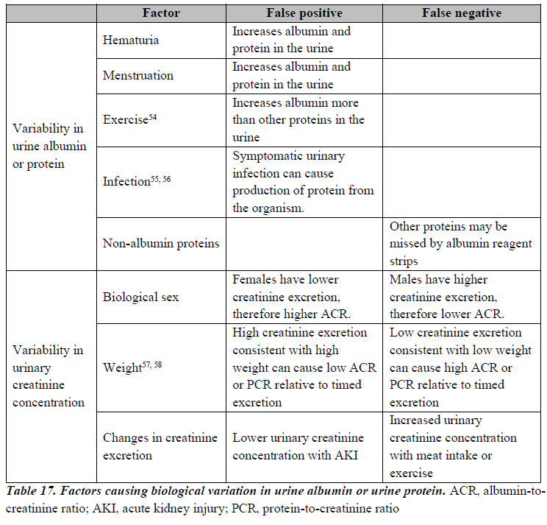
Practice Point: Understand factors that may affect interpretation of measurements of urine albumin and urine creatinine and order confirmatory tests as indicated

Slide 18
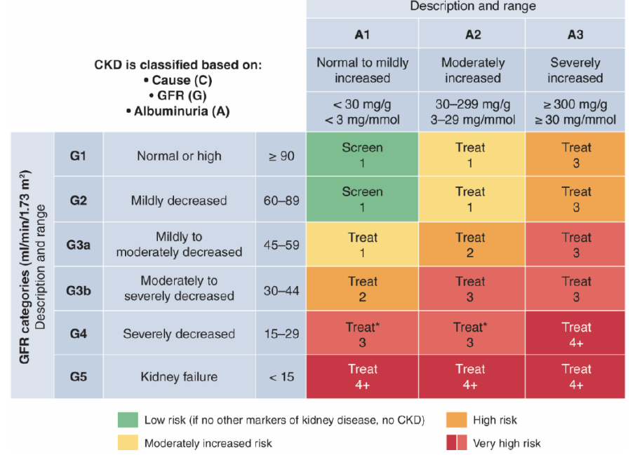

Slide 19
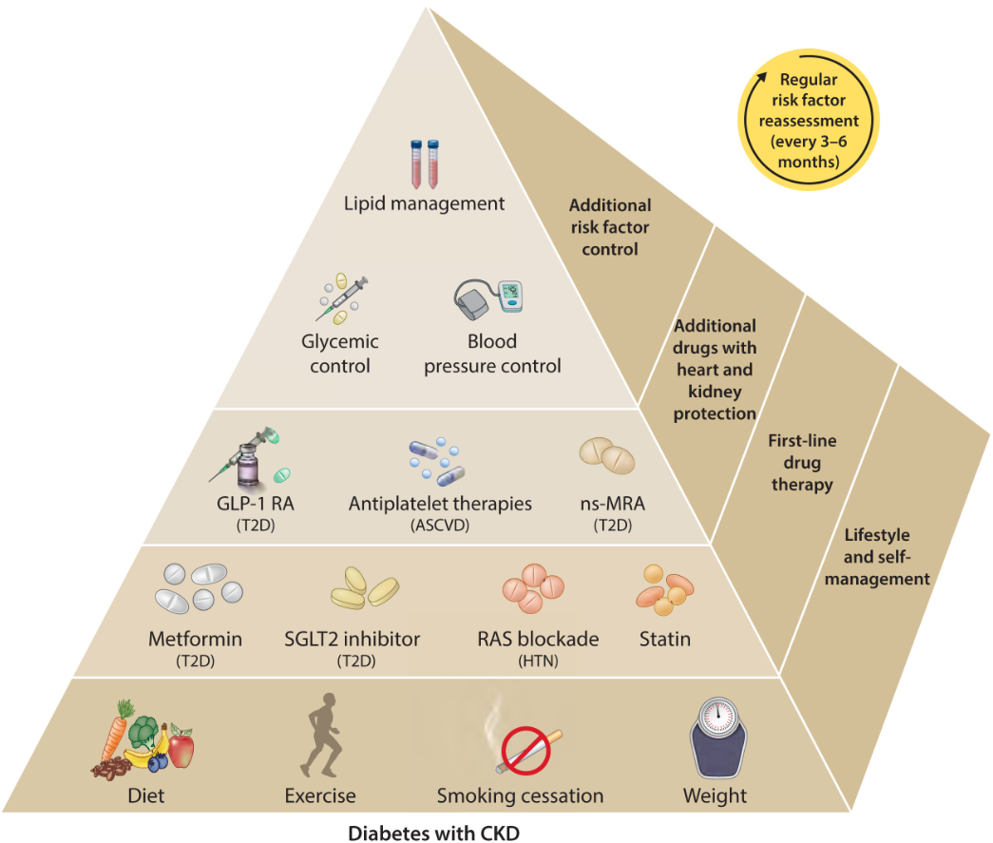
Diabetes & CKD

Slide 20
Renin Angiotensin System (RAS) Inhibitors

Slide 21
Renin-Angiotensin System (RAS) Inhibitors – KDIGO Recommendations
We recommend starting RAS inhibitors (ACEi or ARB) for people with high BP, CKD, and severely increased albuminuria (G1–G4, A3) without diabetes (1B). (Non-diabetic Proteinuric CKD)
We suggest starting RASi (ACEi or ARB) for people with high BP, CKD, and moderately increased albuminuria (G1–G4, A2) without diabetes (2C). (Non-diabetic Proteinuric CKD)
We recommend starting RASi (ACEi or ARB) for people with high BP, CKD, and moderately-to-severely increased albuminuria (G1–G4, A2 and A3) with diabetes (1B). (Diabetic Proteinuric CKD)
We recommend avoiding any combination of ACEi, ARB, and direct renin inhibitor (DRI) therapy in people with CKD, with or without diabetes (1B).

Slide 22
RAS inhibitors – KDIGO Practice Points
RASi (ACEi or ARB) should be administered using the highest approved dose that is tolerated.
Changes in BP, serum creatinine, and serum potassium should be checked within 2–4 weeks of initiation or increase in the dose of a RASi, depending on the current GFR and serum potassium.
Hyperkalemia associated with use of RASi can often be managed by measures to reduce the serum potassium levels rather than decreasing the dose or stopping RASi.
Continue ACEi or ARB therapy unless serum creatinine rises by more than 30% within 4 weeks following initiation of treatment or an increase in dose.

Slide 23
RAS inhibitors – KDIGO Practice Points
Consider reducing the dose or discontinuing ACEi or ARB in the setting of either symptomatic hypotension or uncontrolled hyperkalemia despite medical treatment, or to reduce uremic symptoms while treating kidney failure (eGFR <15 ml/min/1.73 m2).
Consider starting people with CKD with mildly increased albuminuria (A1) with RASi (ACEi or ARB) for specific indications (e.g., to treat hypertension or heart failure with low ejection fraction).
Continue ACEi or ARB in people with CKD even when the eGFR falls below 30 ml/min/1.73 m2.

Slide 25
Sodium-Glucose Cotransporter-2-inhbitors (SGLT2i)

Slide 26
Notes:
Figure 17. Effect of sodium-glucose cotransporter-2 inhibitors (SGLT2i) with kidney disease outcomes by diabetes status. CI, confidence interval; eGFR, estimated glomerular filtration rate; RR, relative risk. Reproduced from Nuffield Department of Public Health (NDPH) Renal Studies Group and SMART-C Impact of diabetes on the effects of sodium glucose co-transporter-2 inhibitors on kidney outcomes: collaborative meta-analysis of large placebo-controlled trials. Lancet Figure 1.406

Slide 27
Notes:
Figure 18. Effects of sodium-glucose cotransporter-2 inhibitors (SGLT2) inhibition versus placebo on cardiovascular and mortality outcomes by diabetes status and trial population. CI, confidence interval; eGFR, estimated glomerular filtration rate; RR, relative risk. Collaborative meta-analysis of data from 13 large placebo control trials of SGLT2 inhibitors. Reproduced from Renal Studies Group and SMART-C Impact of diabetes on the effects of sodium glucose co-transporter-2 inhibitors on kidney outcomes: collaborative meta-analysis of large placebo-controlled trials. Lancet Figure 3.406

Slide 28
SGLT2i – KDIGO Recommendations
We recommend treating patients with T2D, CKD, and an eGFR ≥20 ml/min/1.73 m2 with an SGLT2i (1A). (Diabetic Kidney Disease)
We recommend treating adults with CKD and heart failure or eGFR ≥20 ml/min/1.73 m2 with urine ACR ≥20 mg/mmol with an SGLT2i (1A). (Heart Failure or Proteinuric CKD)
We suggest treating adults with eGFR ≥20 to 45 ml/min/1.73 m2 with urine ACR <20 mg/mmol with an SGLT2i (2B). (Non-proteinuric CKD)

Slide 29
Notes:
Figure 17. Effect of sodium-glucose cotransporter-2 inhibitors (SGLT2i) with kidney disease outcomes by diabetes status. CI, confidence interval; eGFR, estimated glomerular filtration rate; RR, relative risk. Reproduced from Nuffield Department of Public Health (NDPH) Renal Studies Group and SMART-C Impact of diabetes on the effects of sodium glucose co-transporter-2 inhibitors on kidney outcomes: collaborative meta-analysis of large placebo-controlled trials. Lancet Figure 1.406

Slide 30
Notes:
Figure 18. Effects of sodium-glucose cotransporter-2 inhibitors (SGLT2) inhibition versus placebo on cardiovascular and mortality outcomes by diabetes status and trial population. CI, confidence interval; eGFR, estimated glomerular filtration rate; RR, relative risk. Collaborative meta-analysis of data from 13 large placebo control trials of SGLT2 inhibitors. Reproduced from Renal Studies Group and SMART-C Impact of diabetes on the effects of sodium glucose co-transporter-2 inhibitors on kidney outcomes: collaborative meta-analysis of large placebo-controlled trials. Lancet Figure 3.406

Slide 31
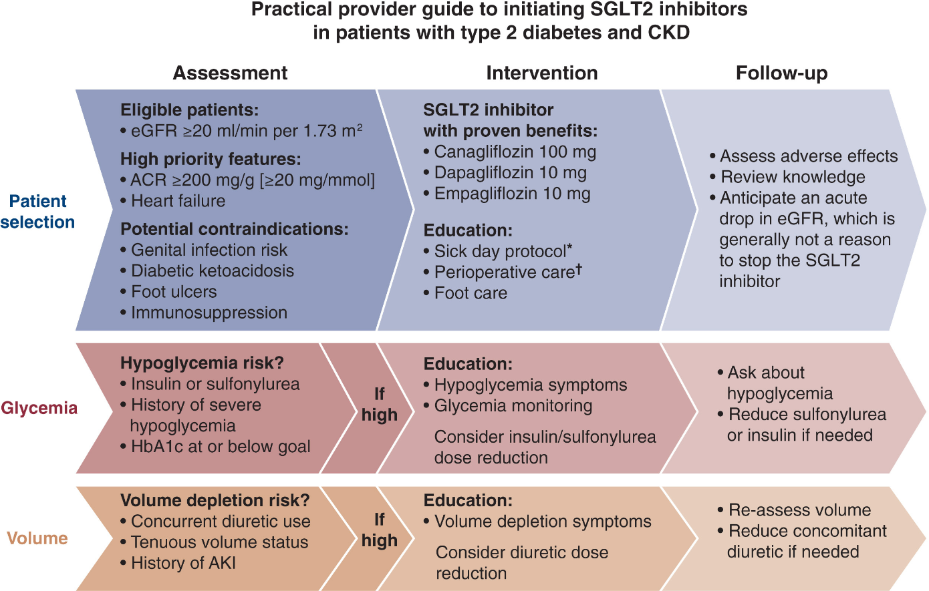

Slide 32
SGLT2i – Practice Points
Once an SGLT2i is initiated, it is reasonable to continue an SGLT2i even if the eGFR falls below 20 ml/min/1.73 m2, unless it is not tolerated or KRT is initiated.
It is reasonable to withhold SGLT2i during times of prolonged fasting, surgery, or critical medical illness (when people may be at greater risk for ketosis).
SGLT2i initiation or use does not necessitate alteration of frequency of CKD monitoring and the reversible decrease in eGFR on initiation is generally not an indication to discontinue therapy.

Slide 33
Mineralocorticoid Receptor Antagonists (MRAs)

Slide 34
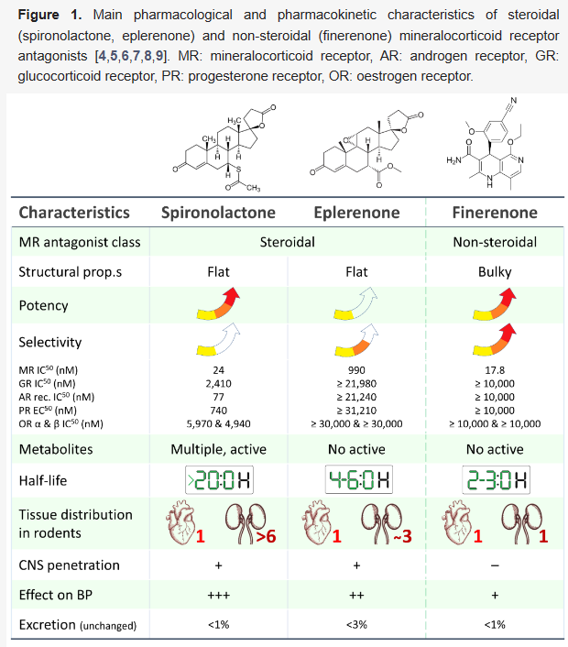
Lullo et al J. Clin. Med. 2023.

Slide 36
Finerenone Initiation and Management

Slide 37
MRA KDIGO Recommendations
We suggest a nonsteroidal MRA with proven kidney or cardiovascular benefit for adults with T2D, an eGFR >25 ml/min/1.73 m2, normal serum potassium concentration, and albuminuria (>3 mg/mmol) despite maximum tolerated dose of RAS inhibitor (2A). (Diabetic Kidney Disease)

Slide 38
MRA KDIGO Practice Points
Nonsteroidal MRA are most appropriate for adults with T2D who are at high risk of CKD progression and CV events, as demonstrated by persistent albuminuria despite other standard-of-care therapies.
A nonsteroidal MRA may be added to a RASi and an SGLT2i for treatment of T2D and CKD in adults.
To mitigate risk of hyperkalemia, select people with consistently normal serum potassium concentration and monitor serum potassium regularly after initiation of a nonsteroidal MRA.

Slide 39
MRA KDIGO Practice Points
A steroidal MRA may be used for treatment of heart failure, hyperaldosteronism, or refractory hypertension, but may cause hyperkalemia or a reversible decline in glomerular filtration, particularly among people with a low GFR.

Slide 42
Glucagon-like Peptide-1 (GLP-1) Agonists
Kidney benefits of GLP1-RA include reduction in albuminuria
May be driven in part by reductions in blood pressure and A1c.
Secondary and exploratory analyses show a promising signal for slowing eGFR decline and reducing risk of progression to kidney failure.
Large RCTs under way.

Slide 43
Kidney Failure Risk Equation (KFRE)

Slide 44
Kidney Failure Risk Equation (KFRE)

Slide 45
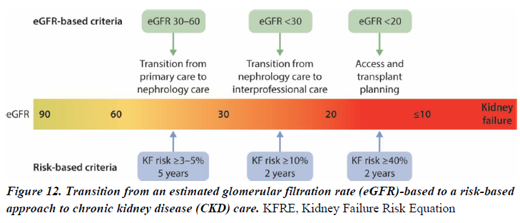
A 5-year KFR of 3%–5% can be used to determine need for nephrology referral in addition to criteria based on eGFR or urine ACR, and other clinical considerations.
A 2-year KFR of >10% can be used to determine the timing of multidisciplinary care (Nephrologist, Renal Nurse, Dietitian, Pharmacist, Social Worker).
A 2-year KFR threshold of >40% can be used to determine the modality education, timing of preparation for kidney replacement therapy (KRT) including vascular access planning or referral for transplantation.

Slide 46
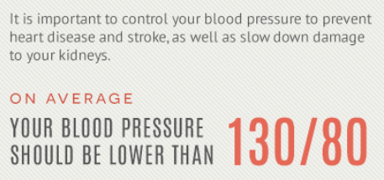
KFRE Example

Slide 47
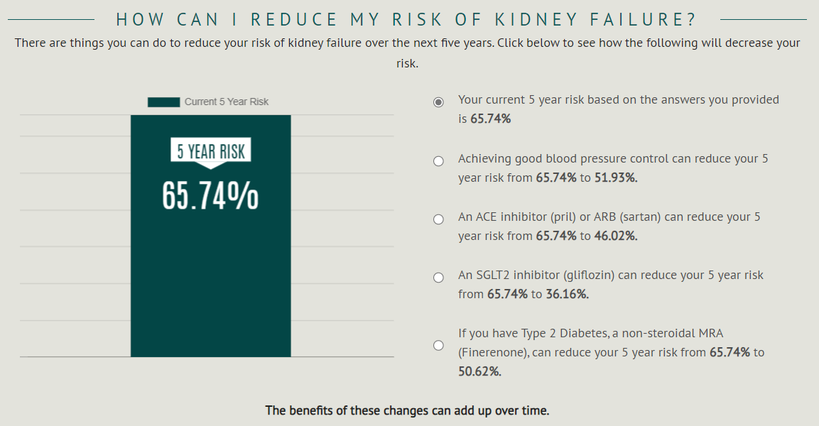

Slide 48
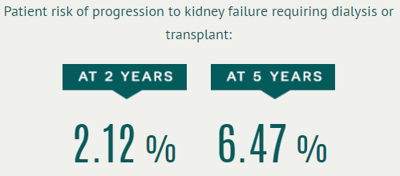
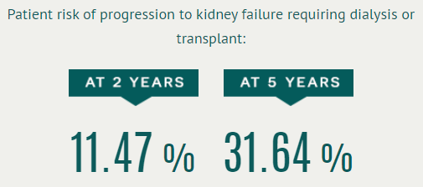
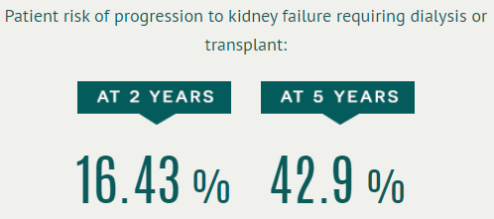
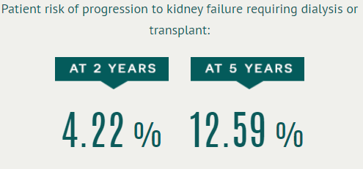
KFRE Examples – 65 F
GFR 25, uACR 1 mg/mmol
GFR 25, uACR 100 mg/mmol
GFR 35, uACR 500 mg/mmol
GFR 35, uACR 50 mg/mmol

Slide 49
Summary
Proteinuria is an important modifiable risk factor in CKD impacting morbidity and mortality.
Nephritic Syndrome is a medical emergency = Call Nephrology.
RAS inhibitors, SGLT2 inhibitors and MRAs are disease modifying agents for the management of proteinuric CKD.
RASi indicated in all Proteinuric CKD (both diabetic and non-diabetic)
SGLT2i indicated in Diabetic Kidney Disease, Proteinuric and Non-Proteinuric CKD, and Heart Failure
nsMRA indicated in Diabetic CKD
The KFRE is useful tool to estimate kidney failure risk and determine timing of Nephrology referral and kidney replacement therapy interventions.

Slide 50
Thank you! Questions?

